Slide 1
‘Welsh Bacc’
The “Why and What”

Slide 2
The “Why”
To develop essential and employability skills
To develop attributes and behaviours valued by post-16 educators and employers
To learn and apply skills within purposeful tasks
To think of skill development as being a key part of education and life long learning

Slide 3
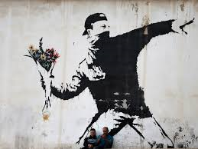
Skills
Literacy
Numeracy
Planning &
Organisation
Critical
Thinking &
Problem
Solving
Creativity &
Innovation
Digital
Literacy
Personal
Effectiveness

Slide 4
The “What”
Title | % Weighting | Max. Marks | Timescale
Enterprise & Employability | 20% | 36 | June – December
Global Challenge | 15% | 36 | January – Easter
Community Challenge | 15% | 36 | Easter - Summer
Individual Investigation | 50% | 96 | September – Easter (Yr 11)

Slide 5
The “What”
Title | Overview
Enterprise & Employability | Learning about your own skills Running a business Adopting roles and responsibilities Producing product Pitch and Visual Display
Global Challenge | Understanding of Child Poverty Using sources Personal Standpoint Raising Awareness Campaign

Slide 6
The “What”
Title | Overview
Community Challenge | Skills Audit Planning and Organising your own sessions for coaching or educating others Running sessions Self reflection/evaluation
Individual Investigation | Choice of topic and titles Independent learning Research skills Referencing Collecting and analysing primary data Self reflection/evaluation

