Slide 1
Welsh Baccalaureate
Enterprise and Employability Challenge

Slide 3
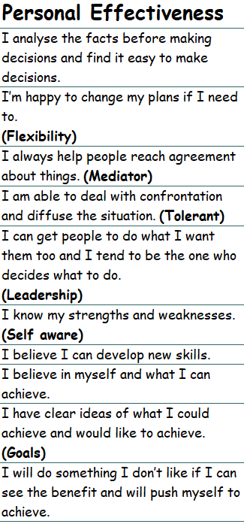
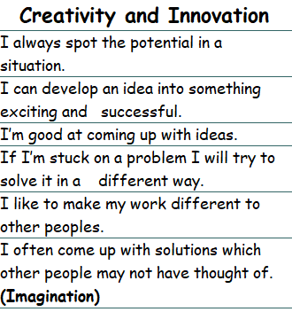
The skills you are assessed in include Creativity and Innovation and Personal Effectiveness.
Refer back to your skills audit you completed in September and take a copy of your whole audit. If you have not completed this you need to do this first

Slide 4
Your design brief:
Create a unique product which can be sold over the Summer Royal Welsh Showground. This product could:
Be something which reflects your local area and can bought by a tourist,
Be based on a traditional product with a twist,
Provide a solution to a problem
Or be given as a gift.

Slide 5
Challenge outline
Understand the process and the 5 Ps
Skills audit- identify strengths and weaknesses
Understand company roles, apply for a role and justify team
Understand how and why to keep minutes. Decide on company name, logo and branding
Design a product considering the 5Ps . ACCESSFM
Market research and develop product
Understand how to deliver a pitch
Plan and deliver pitch
Evaluate skills developed in challenge

Slide 6
Assessment
Band 1 (1-3 marks) – limited audit of personal and team skills including plans for improvement.​
Band 2 – (4- 6 marks) – basic audit of personal and team skills including plans for improvement.​
Band 3 – (7-9 marks) – detailed audit of personal and team skills including plans for improvement.​
Band 4 – (10 – 12 marks) – detailed and effective audit of personal and team skills including plans for improvement.

Slide 7
