Slide 1
Global Citizenship Home Resource Pack

Slide 2
Session 2b:
ANALYSING SOURCES
For PESTLE

Slide 3
Objectives
To explore the meaning of each PESTLE factor and identify key vocabulary associated with each one.
To analyse sources of information for relevant PESTLE factors.

Slide 4
skills
Critical Thinking and Problem Solving:
Produce a Personal Standpoint including own and alternative opinions, views, and arguments;
Consider the credibility of sources;
Apply problem solving and decision making techniques:
Identify relevant political, economic, social, technological, legal and environmental factors;
Reflect on critical thinking and problem solving process.

Slide 5
Starter:PESTLE Vocabulary
In your workbook, make a list of key vocabulary associated with each of the following words:
For example,
A word associated with Political would be government
Use a dictionary and / or the internet
to help you.
Political | Economical | Social | Technological | Legal | Environmental

Slide 6
Why do we need to “PESTLE”?
Global issues can affect societies in a number of different ways and are often broken down into mnemonic (technique to remember) PESTLE categories, like pieces of a puzzle.
Understanding these categories gives us a “bird’s eye view” of the global issue we are studying from many different angles.
It helps us to consider alternative opinions, views, and arguments in more depth, whilst developing our own personal views or standpoint.

Slide 7
What does
P E S T L E
stand for?

Slide 8
P = Political
... E S T L E
Think about…
What is the political impact of the global issue?
How is the government affected by the problem?

Slide 9
E = Economical
P ... S T L E
Think about…
What is the financial (money) impact of the global issue?
Who is affected financially?

Slide 10
S = Social
P E ... T L E
Think about…
How does the global issue affect people?
Are some people in society affected more than others?

Slide 11
T = Technological
P E S ... L E
Think about…
Are there any technological factors associated with the global issue?
What are the innovations in technology that may affect the issue?

Slide 12
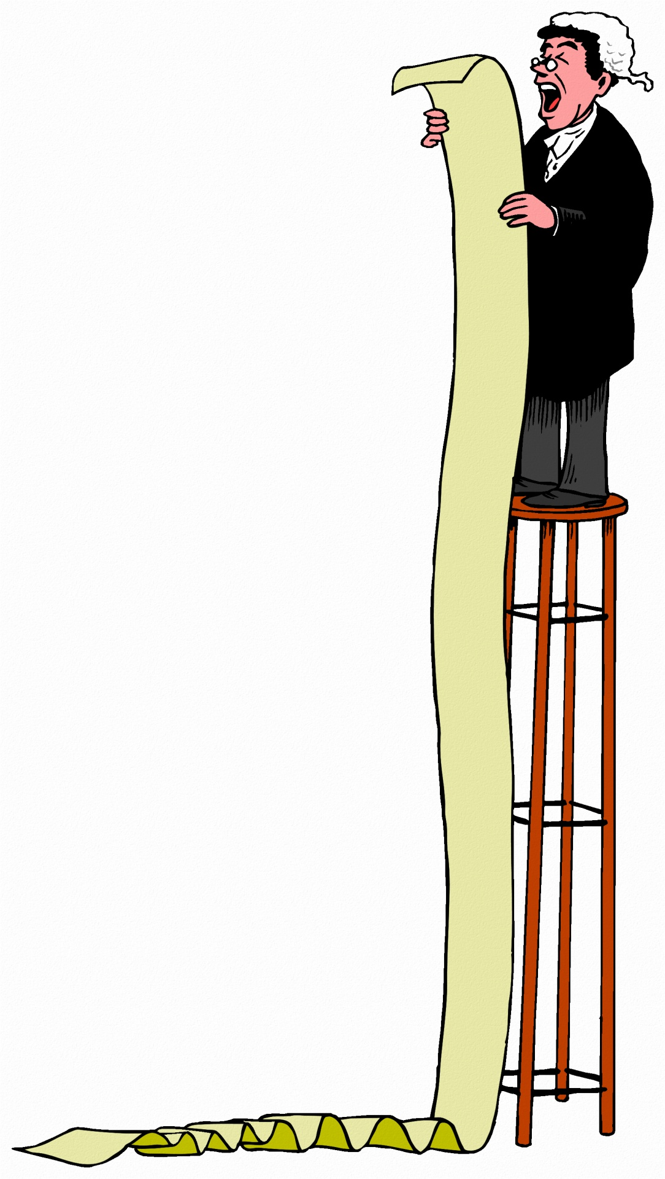
L = Legal
P E S T ... E
Think about…
Are there any legal issues considered?
Is the law being broken?

Slide 13
E = Environmental
P E S T L ...
Think about…
What is the impact of the global issue on the natural environment?
How is it affected?

Slide 14
Skills Builder
Last session, you learned how to identify key information in Sources 1 & 2 by applying the techniques of reading, highlighting and annotating.
To develop your critical thinking and problem solving skills further, you will apply these techniques in the same way to identify P E S T L E factors in the same sources.

Slide 15
Task 1:PESTLE Source Analysis
Look at Source 1 & 2 again in your workbook (clean copies on pages 2 & 4 of your workbook for Session 2b).
Create a colour code and key (choose any 6 colours) and go through each source highlighting relevant P E S T L E factors.
Complete a PESTLE analysis for each source outlining which factor relates to the global issue of Food Poverty.

Slide 16
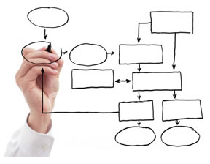
Plenary
Word Association Game
Ask a few family members, friends or neighbour what words come to mind when they hear the P E S T L E
mnemonic categories:
Record answers in your workbook.
Political | Economical | Social | Technological | Legal | Environmental
Extension:
Think of another global issue.
What P E S T L E factors can you link to that issue?

