Slide 1
Global Citizenship Home Resource Pack

Slide 2
Session 3:
CREDIBILITY OF SOURCES

Slide 3
Objectives
To develop Critical Thinking and Problem Solving skills through the evaluation of sources of information for credibility.

Slide 4
skills
Critical Thinking and Problem Solving:
Produce a Personal Standpoint including own and alternative opinions, views, and arguments;
Consider the credibility of sources;
Apply problem solving and decision making techniques:
Identify relevant political, economic, social, technological, legal and environmental factors;
Reflect on critical thinking and problem solving process.

Slide 5
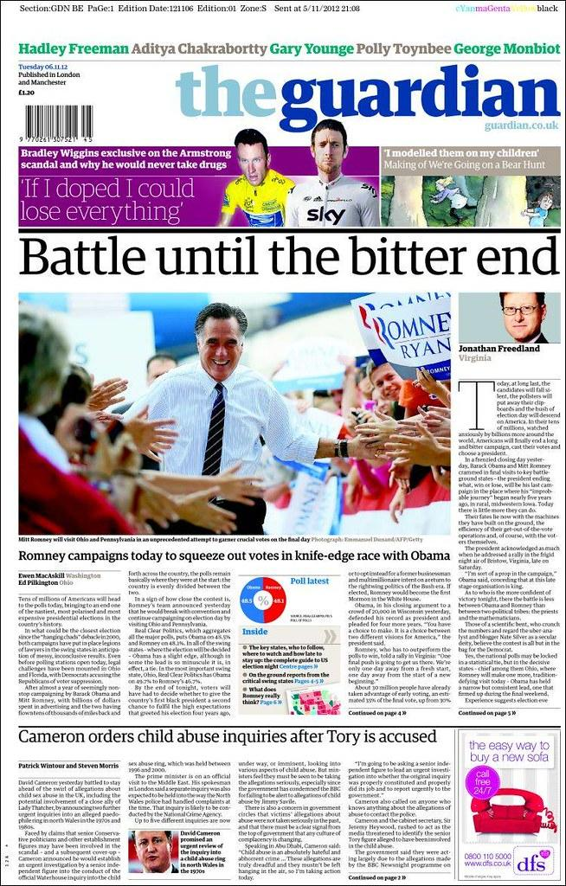
Starter: Can it be Trusted?
Look at the following sources of information. Which one do you think is the most reliable and why?
Image 1
Image 2
Image 3
Record your answers in your workbook.

Slide 6
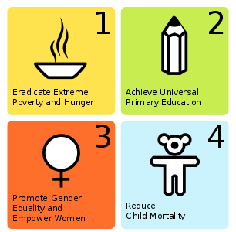
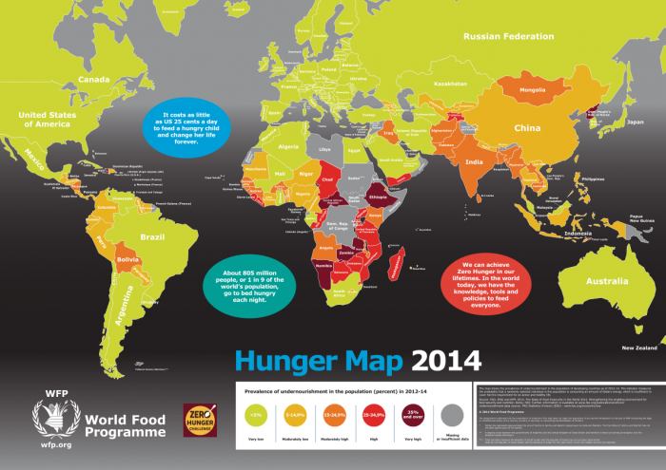
Types of Sources of Information
Information about global issues comes from many different types of sources.
For example,
Books News Media
Infographics Maps
We need a range of sources of information to:
get answers to questions about various global issues
gather alternative views and opinions
develop our own standpoint on global issues

Slide 7
Why is it important to Evaluate Sources?
More information is at our fingertips than ever before, and the amount of information makes it even harder to determine which information can be trusted.
Understanding how to assess the credibility of the information you come across is essential for you to develop the skills you need to critically evaluate sources for yourself.

Slide 8
How far can we trust the Internet?
There are billions of different websites. Anybody can set up a website and publish anything they want. Information on the internet isn't always true, so look out for the signs of an accurate website.
Look at the suffixes for clues...
.com - The "standard" ending to web address often used by commercial organisations
.org - Generally used by not for profit organisations
.org.co.uk - A company's website based in the UK
.gov.uk - a government website
.ac.uk / .sch.uk - a University, college or school website
For further guidance go to:
https://www.usg.edu/galileo/skills/unit07/internet07_08.phtml

Slide 9
Does it really matter where information comes from?
YES!! The type of source and information they publish can influence its purpose and intended audience. For example...
Sources | Information about Sources
Guardian Newspaper | This is a British newspaper with Left-wing tendencies (Labour and some Lib Dems).
BBC Newsround | A programme produced by the BBC with news items for young people.
Fairtrade Wales | An organisation that stands for farmers’ rights.
The Times Newspaper | · British newspaper with centre tendencies (mixed political views). ·
Save the Children | A charity organisation, working around the world to ensure children have a decent quality of life and that their rights are protected.
YouTube | A social media platform that allows anyone to upload videos. The site is monitored for decency.

Slide 10
Techniques for Evaluating Sources
There are a number of techniques you can use to help you evaluate sources of information.
Using acronyms can help you to ask the right questions about what has been said, why it was said and how far can we trust what it tells us about the global issue.
Two acronyms you could use are...
C
R
A
A
P
OR
R
U
R
U

Slide 11
C
Currency
When was the information published or posted? Has it been revised or updated? Is the information current or out-of date for your topic?
R
Relevance
Does the information relate to your topic or answer your question? Who is the intended audience?
A
Authority
· Who is the author/publisher? Are the author's credentials given?
· Does the URL reveal anything about the author or source?
A
Accuracy
Where does the information come from? Is the information supported by evidence? Can you verify any of the information in another source or from personal knowledge?
P
Purpose
What is the purpose of the information? To inform? Teach? Sell? Entertain? Persuade? Is the information based on fact or opinion?

Slide 12
Relevant
How relevant is the source to your enquiry?
What does it tell you?
Has it left out important information?
Why was the source produced?
R
U
Useful
How useful is the source to your enquiry?
Is it full of facts or is it based on opinion?
Was the information produced by an expert? Are they biased? Does the author stand to benefit from their position/viewpoint?
Reliable
How reliable do you think the information is?
Who produced the source? Is the source well-known and trustworthy?
What kind of publication is the source – a scientific report, an eye-witness or a work of fiction?
R
Up-to-date
When was the source published?
Is it current and up-to-date?
Does the date of publication affect its reliability? Give reasons.
U

Slide 13
Task 1:How Credible is it?
All sources of information have an “attribution.”
This simply means that it tells you where the information came from.
Look at the attributions for Sources 1 & 2 in your workbook.
Choose either
or
to help you think critically about the credibility of each source.
C
R
A
A
P
R
U
R
U

Slide 14
Plenary
In your workbook, create a
Top Tips
checklist of the main points to consider when evaluating sources of information for credibility.
Extension:
Look back at the starter activity. Can you comment in more depth about the credibility of these sources using your own checklist?

