Slide 1
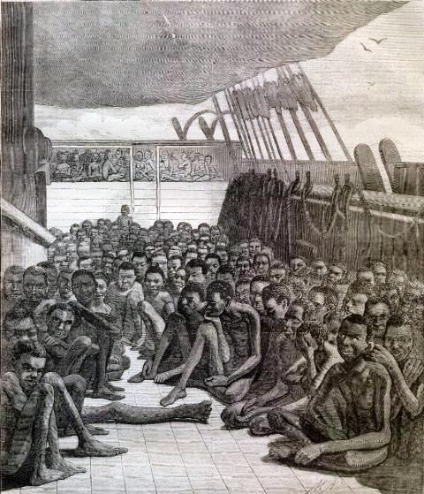
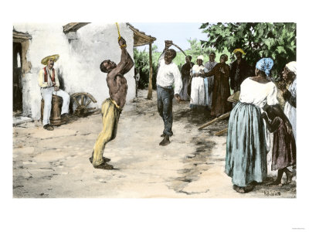
Slave Plantation
Learning Objectives:
To be able to explain what a slave plantation is.
To be able to use a primary source to gain information about a slave plantation.
Starter:
In the thought bubble, write what you think the person would be thinking at that moment.

Slide 7
What does this source tell us about life on a ranch?
Can we believe what we see in this picture?

Slide 8
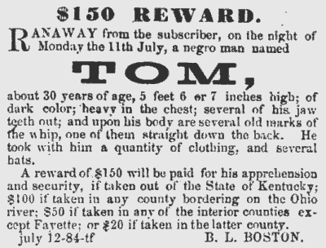
What can we tell about life on a plantation from this source?

Slide 9
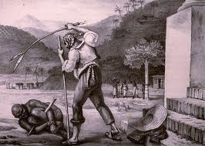
The sources
Each table group will be given a source.
Highlight anything that the source tells us about life on a plantation.
These words may help you:
Fearful
Painful
Violent
sad
Helpless
Alone
Powerful

Slide 10
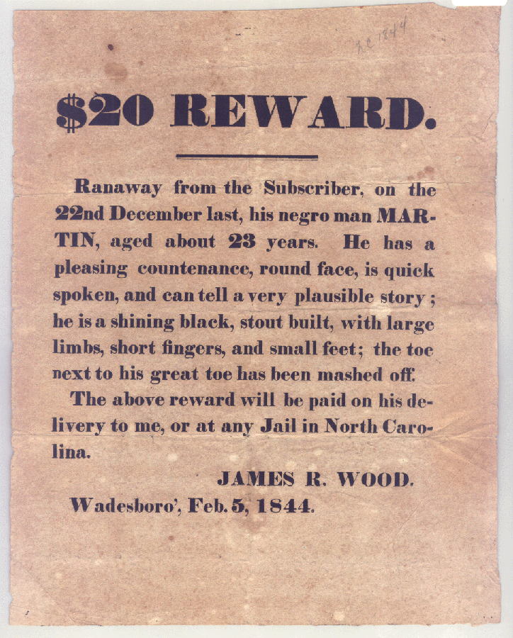

Slide 11
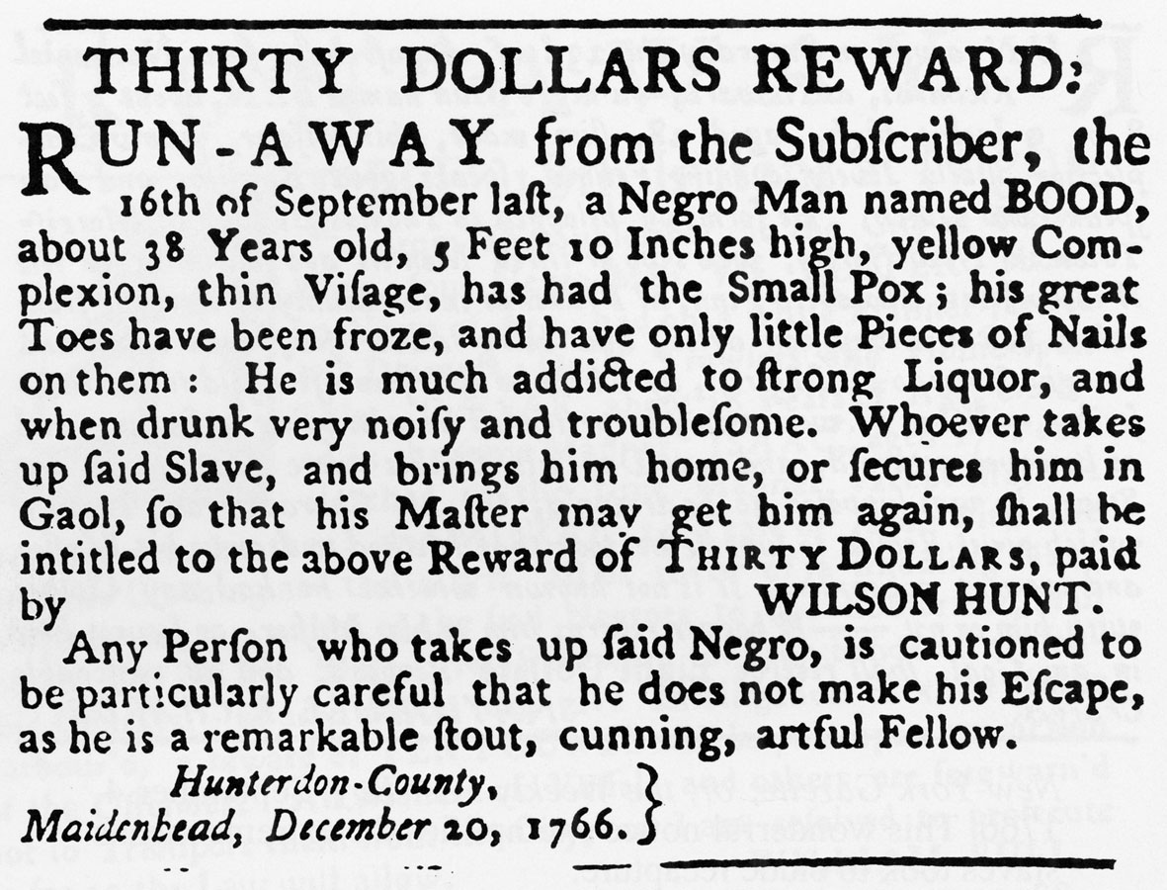

Slide 12
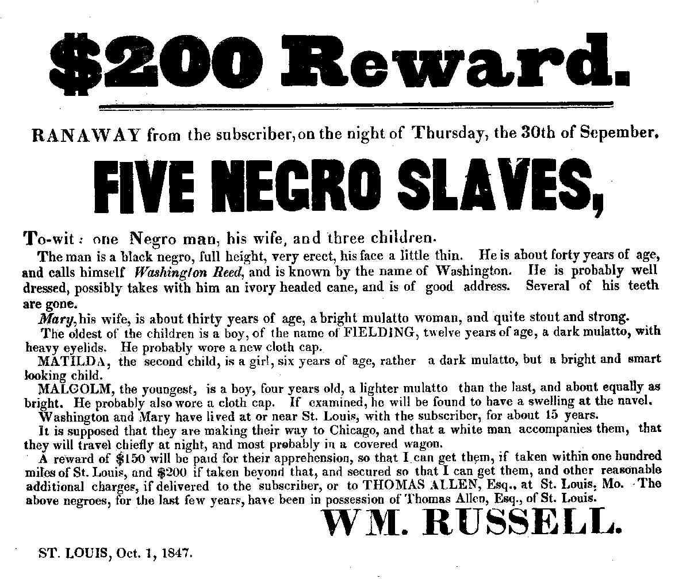

Slide 13
Point - Evidence
We are going to use the information we have gained from the sources to explain what life may have been like on a plantation.
The reward poster suggests that life on the plantation was........................
For example, it says......................
Violent
Fearful
Painful
sad
Helpless
Alone
Powerful

Slide 14
Point - Evidence
The reward poster suggests that life on the plantation was ................................
For example, it says...................................
Violent
Fearful
Painful
sad
Helpless
Alone
Powerful

Slide 15
Group Task
Using your source, you are going to create a drama presentation about a slave escaping from a plantation.
Your presentation is going to be in the style of:
A news report
Crimewatch
A Soap Opera (Corrie/ Eastenders)

Slide 16
Have you met your objectives? To gain information about life on the plantations from primary sources. On your post-it note write one thing you have learned today about what life was like on a slave plantation.

