Slide 1
Why was slavery abolished?

Slide 2
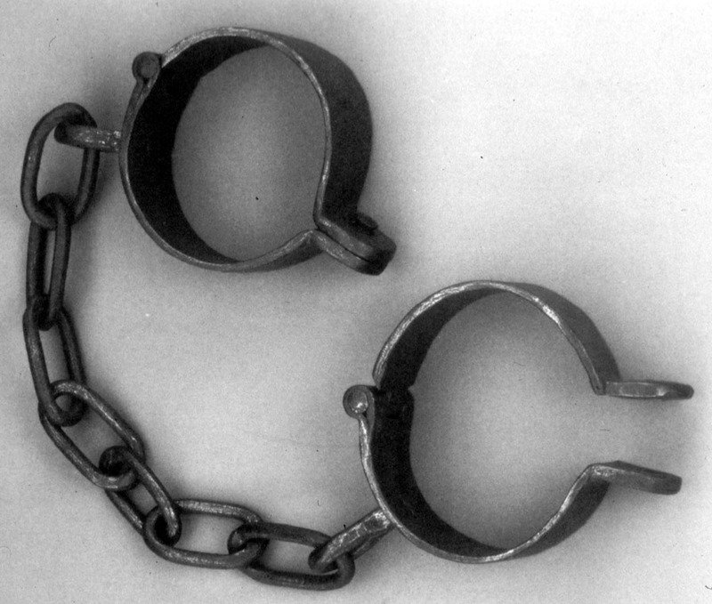
What would your reaction be if someone proudly said…
“Yes, I still own a slave!”

Slide 3
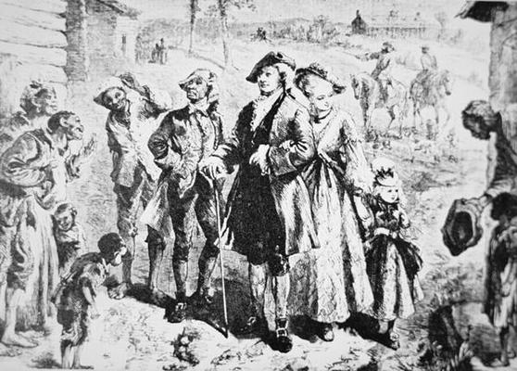
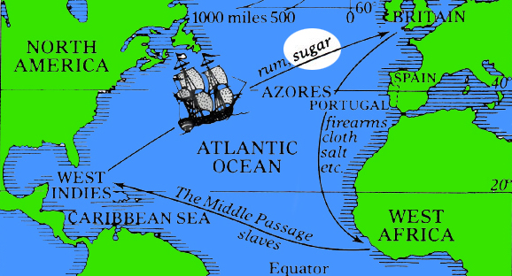
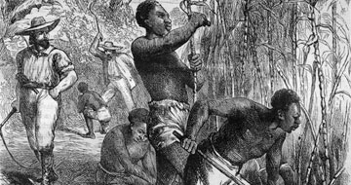
If you had asked that question in the late 1700s, the answer might have been very different from yours!
In the 18th and 19th Centuries, some very rich people proudly owned slaves – and the wealth of the cities in which many of them lived had been built on the slave trade.

Slide 4
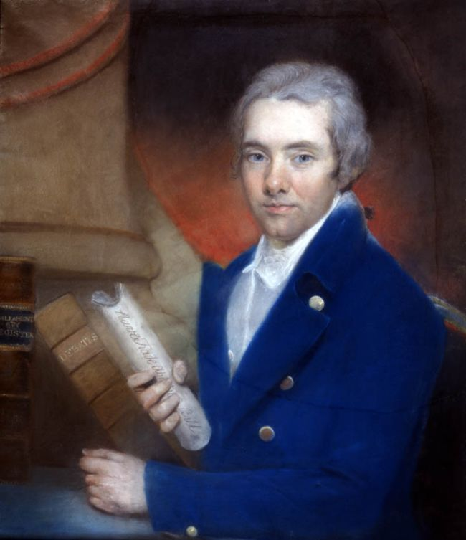
However…
By the end of the 19th Century, some people were starting to believe that the slave trade was wrong.
Title: Abolition of slavery
Date: ____________
One of the loudest voices against slavery was William Wilberforce
Using your knowledge from last lesson, can anyone give me a reason why pe
Notes:
http://www.bbc.co.uk/learningzone/clips/interpretations-of-the-abolition-of-slavery/10130.html

Slide 5
Task:
Working in pairs:
Each of you draw this line across a page in your books.
Earliest event
Last event
Bright Sparks
Make a note of the top 5 events from the life of
William Wilberforce.
Make an illustrated timeline of his life.

Slide 6
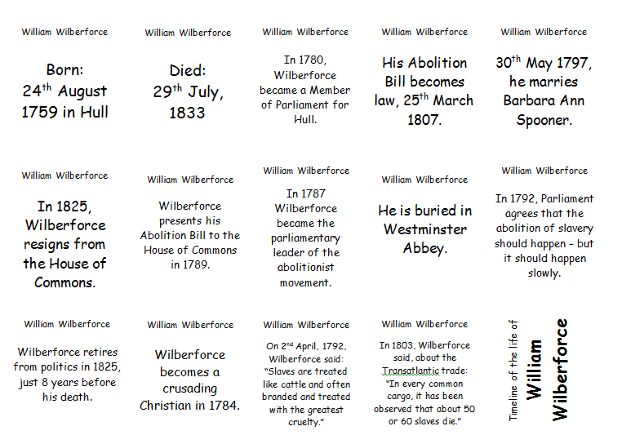

Slide 7
Lots of people agree that William Wilberforce was VERY important in bringing about the abolition of slavery…
…but other people would argue that Wilberforce was just one voice out of lots and lots and lots of other people who wanted to abolish slavery.
Abolishing the slave trade couldn’t have happened overnight…
Slavery was a way of life, and people in Britain had been involved with slavery for hundreds of years by the 1800s.

Slide 8
So, why did Britain decide to abolish the slave trade in 1807?
In the end, there were many reasons:
2nd task challenge:
Working in pairs:
Look at the William Wilberforce cards - On the back there are 15 statements about why Britain eventually decided to abolish slavery.
In groups, rank each statement out of 10 (1=Not important and 10= Very important)
Bright Sparks
Why did Britain abolish slavery?
Aim for at least 3 reasons

Slide 9
Which section has the most cards in it?
So, why did Britain decide to abolish slavery?

Slide 10
Notes:
http://www.youtube.com/watch?v=dnV_MTFEGIY

