Slide 1
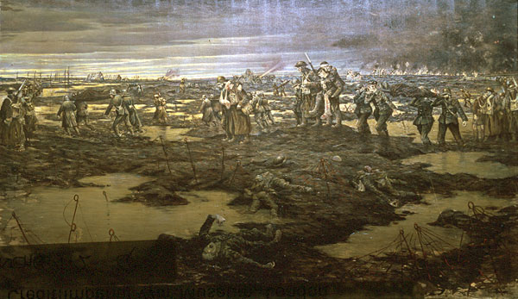

Slide 2
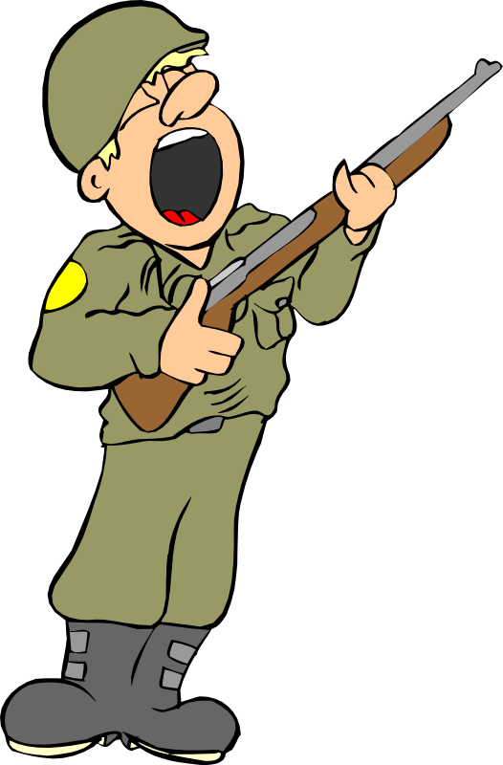
Attack the Trench!

Slide 3
Learning Objectives
To identify different WW1 weapons
To compare advantages and disadvantages of weapons in WW1
To plan an attack on a trench using WW1 weapons

Slide 4
Welcome to the wonderful world of World War 1 Weapons!
Welcome to the wonderful world of World War 1 Weapons!
For each weapon think of 1 good thing and 1 bad thing about it.

Slide 5
Welcome to the wonderful world of World War 1 Weapons!
For each weapon think of one good thing and one bad thing.
For each weapon think of 1 good thing and 1 bad thing about it.

Slide 6
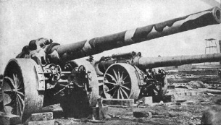

Slide 7
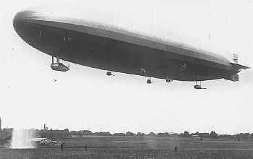

Slide 8
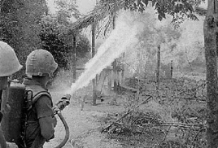

Slide 9
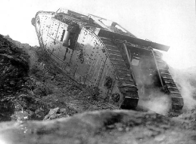

Slide 10
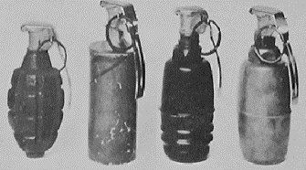

Slide 11
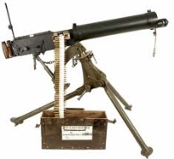

Slide 12
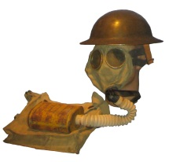

Slide 13
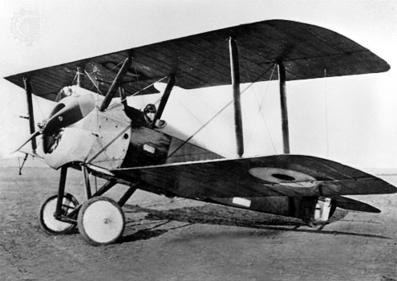

Slide 14
You have £4,000 to attack the enemy trench.
You have 80 men, all of whom have a rifle but you’re gonna need a bit more than that to kill the enemy and destroy their trench!

Slide 15
Welcome to the wonderful world of World War 1 Weapons!
So how will you attack the trench?
For each weapon think of 1 good thing and 1 bad thing about it.

Slide 16
Challenge
Write an account of how effective the weapons of trench warfare were [8 marks]
TIP: Explain how different weapons would be effective in different situations

Slide 17
https://www.youtube.com/watch?v=k7v3cq1ZJjM

