Slide 1
22nd June
How did the Nazi’s change the life of Jews
in Germany?
List three Human Rights that you have as an individual.
1.
2.
3.

Slide 2
I am not able to explain how the Nazi’s changed the lives of Jews in Germany.
I can attempt to explain how the Nazi’s changed the lives of Jews in Germany but I am not able to do it in much detail.
I am confident that I can explain how the Nazi’s changed the lives of Jews in Germany and can describe the effect this had on the lives of the Jews.

Slide 3
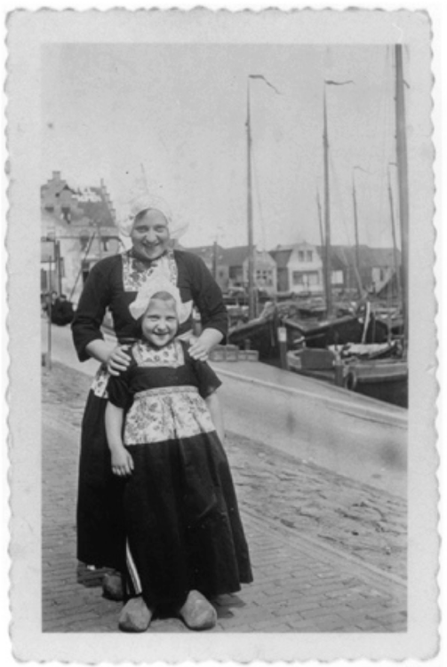
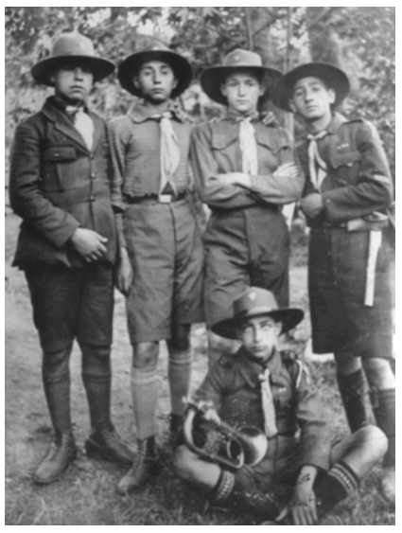
Jewish Life (before 1933)

Slide 4
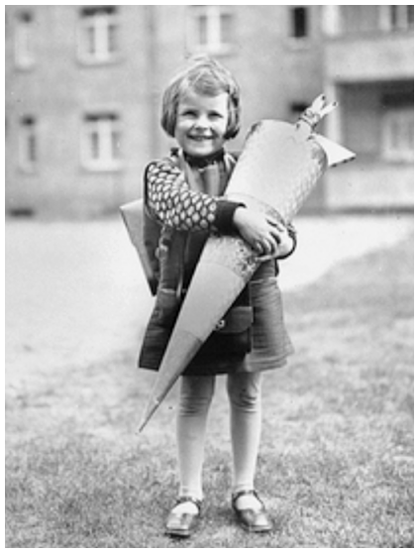
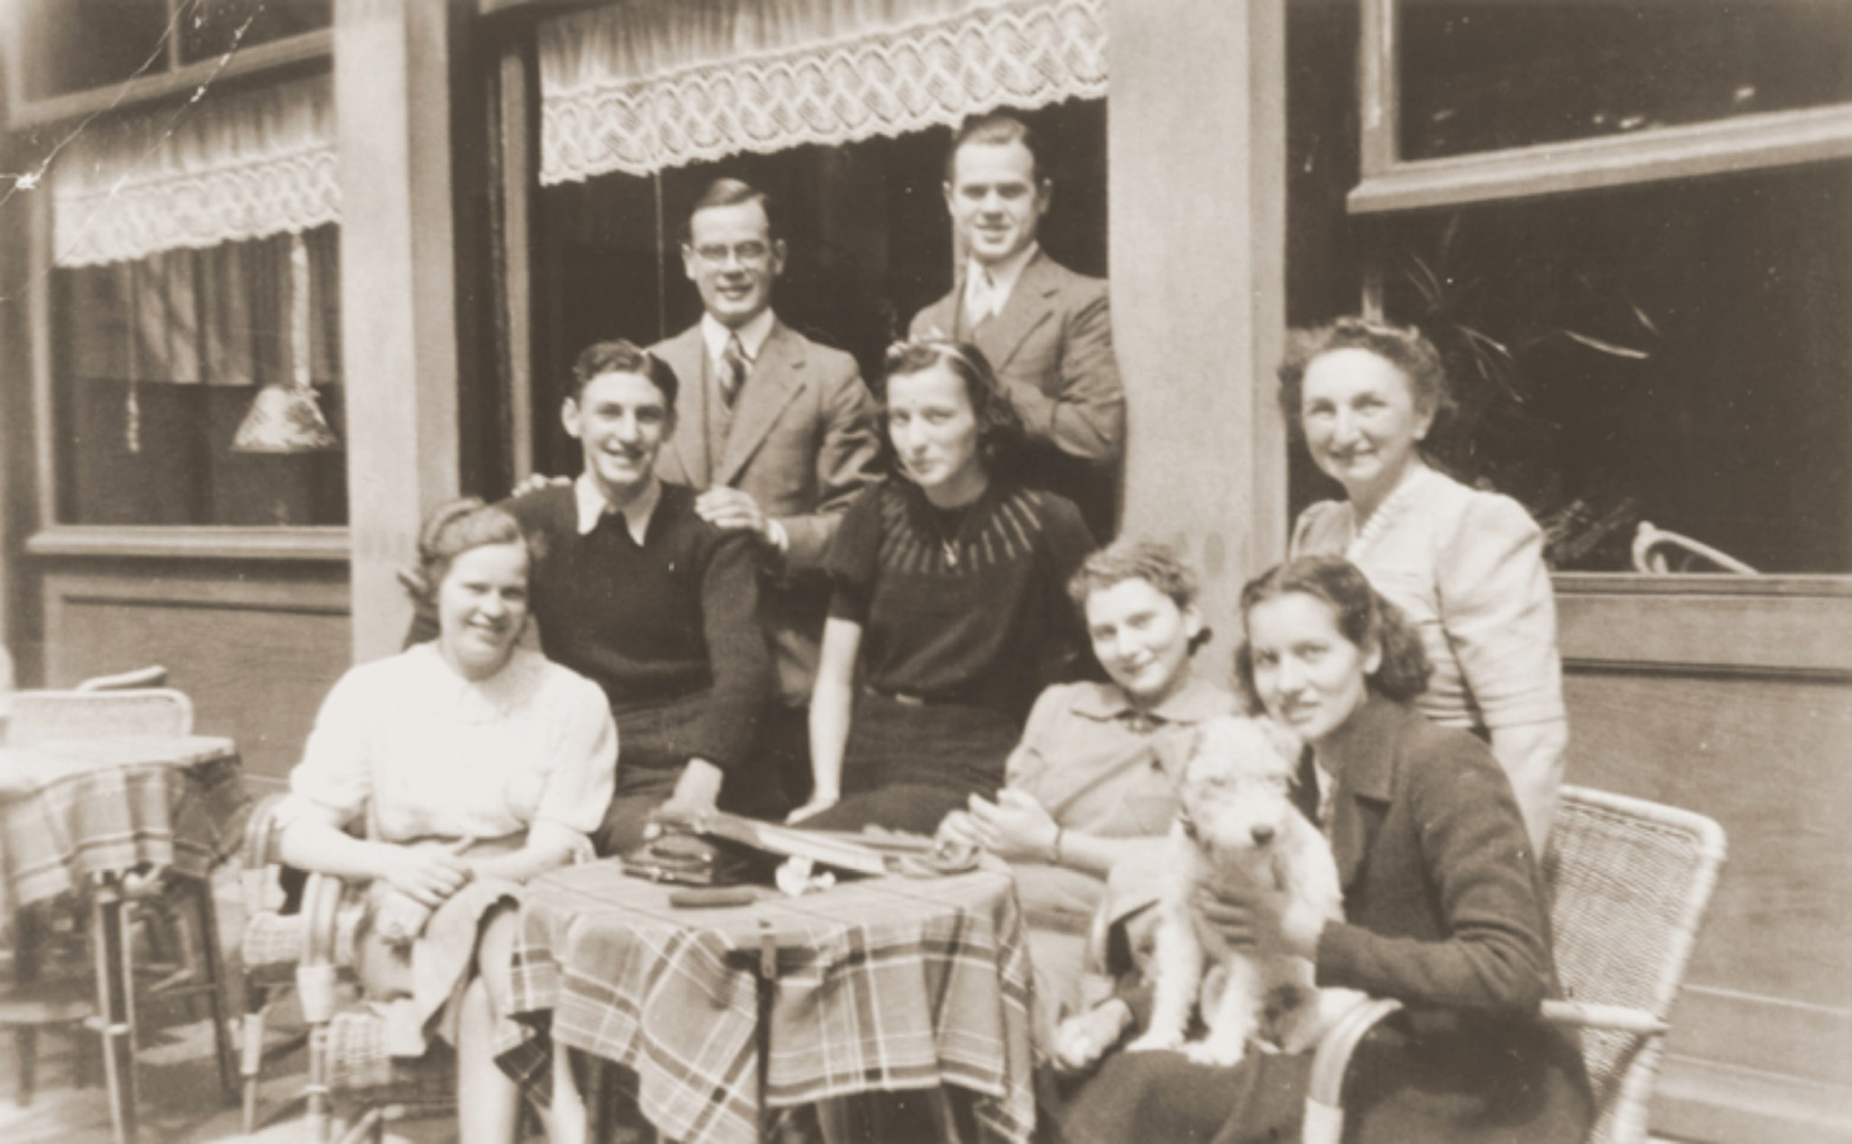

Slide 5
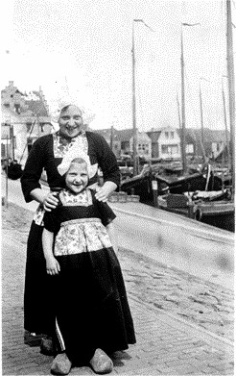
This photograph of Irma and Ursula was taken in the 1930s, and shows them on holiday in the Netherlands.
A German-Jewish family, the Klipsteins managed to escape Germany and find refuge in Belgium.
In 1942 they went into hiding with a non-Jewish family in a suburb of Brussels. The family was denounced to the Gestapo in 1943, and Irma and her husband Leo were arrested.
Ursula was not arrested as she was assumed to be the daughter of a Christian family.
Irma and Leo survived the war.
The family were reunited at the end of the war and migrated to the USA in 1947. The Klipstein story touches on a number of important themes, including escape and rescue, betrayal and hiding, and the rebuilding of family life after the Holocaust.
Irma Klipstein and her daughter Ursula taken on a visit to Volendam, Netherlands.

Slide 6
Among those pictured is Samuel Rouben. During the war, Samuel was due to be transported to Auschwitz from Greece with his wife, but they managed to escape from the transit camp.
They drove to the Italian consulate where they were given papers and train tickets to Athens.
They then hid with a Greek Orthodox priest for the final two years of the war.
Samuel’s story draws our attention to the geographical scale of the Holocaust, whilst also raising issues of aid and rescue.

Slide 7
Berta Rosenhein, Leipzig.
Berta Rosenhein is shown here holding her “Schultüte” – school cone – in 1929. The cone is full of sweets, and was (and still is) traditionally given to all children on their first day of school in Germany.
In its own small way this photograph is an indication of the thorough integration of the Jewish community into German society in the early twentieth century.
Berta came to Britain as a teenager in 1939, as one of the almost 10,000 unaccompanied children rescued through the Kindertransport programme.
She lived with a family in Bromley. Berta’s mother Irma was deported to Riga and murdered in 1943. After the war, Berta migrated to New York.

Slide 8
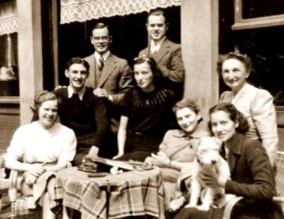
The Jacobsthals were a German-Jewish family who moved to the Netherlands in 1929.
Hilde is seated in the lower-right corner. When the Nazis began to deport Jews from Amsterdam in 1942, Hilde worked in the crèche where Jewish children were held prior to deportation and helped to organise their rescue.
After her parents were deported in 1943, she escaped and joined the resistance movement in Belgium.
At the end of the war Hilde went to work with the Red Cross at Bergen-Belsen. She later married a Swiss doctor, migrating first to Israel and then moving to the USA in 1950.
The Jacobsthal family outside a café, Amsterdam.

Slide 9
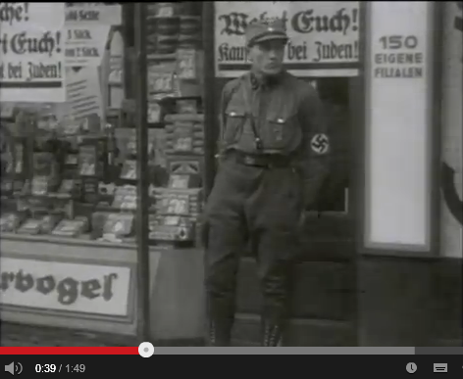
Persecution Begins
Watch the short video clip
Write down one way that the Jews were persecuted from 1933.
Notes:
Click on image to be directed to YouTube video or click - https://www.youtube.com/watch?v=RJIbWk66n88

Slide 10
I am not able to explain how the Nazi’s changed the lives of Jews in Germany.
I can attempt to explain how the Nazi’s changed the lives of Jews in Germany but I am not able to do it in much detail.
I am confident that I can explain how the Nazi’s changed the lives of Jews in Germany and can describe the effect this had on the lives of the Jews.

Slide 11
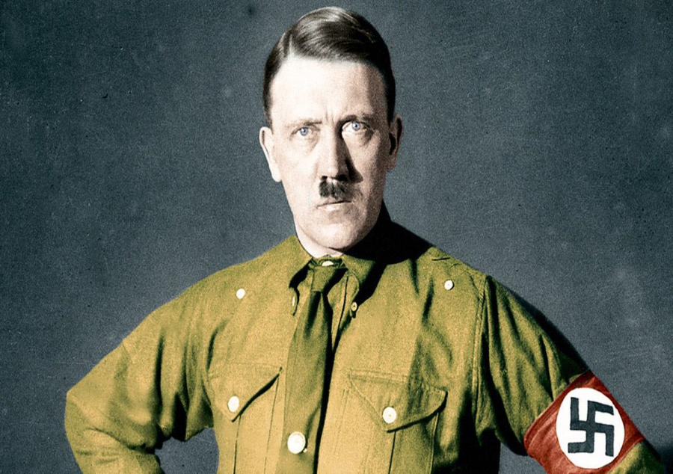
How did it all begin?
The Nazi party were voted into the German Government in 1933. By 1934 Hitler had become a dictator. This meant he had total control over all the laws in Germany.
It’s from these early years that laws began to appear that made a GRADUAL change to Jewish people’s lives.
Why do you think the Nazi party had to change laws GRADUALLY?

Slide 12
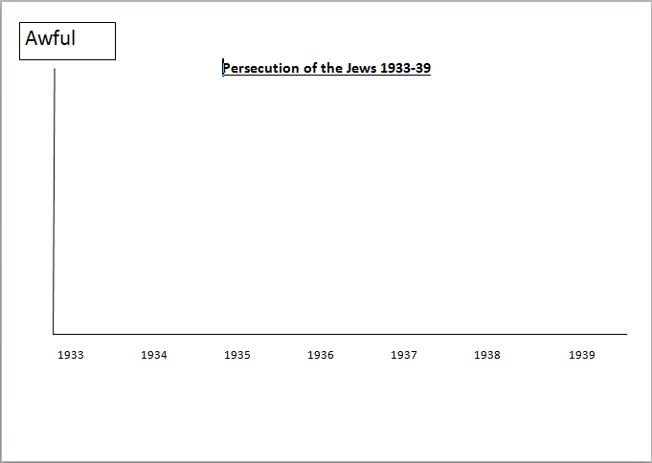
You will be given a sheet detailing new laws that were introduced by the Nazis towards the Jews through out the 1930s.
I want you to complete your living graph by placing the events on the correct dates and in the correct level of severity.
The more severe you think the restriction is, the closer it would go to the top of your graph.
Choose two restrictions. Write a few sentences to EXPLAIN how this would impact the life of a Jewish person and how they would feel about this.

Slide 13
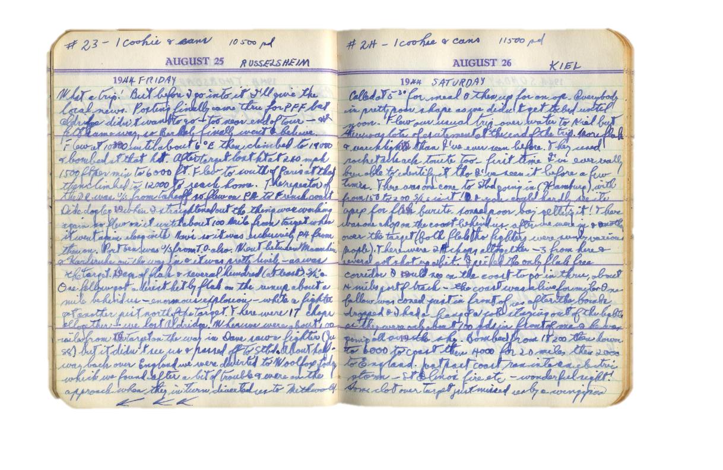
Dear Diary….
Write a diary entry for one day in 1940.
I want you to explain the new laws that have been introduced between 1933 and 1940 and how they have affected your life.
Think about impact on: school, work, leisure.
Sentence Starters | Connective Words
Today I….. | Although
Another new law was introduced… | However
This makes me feel… | In addition to
I no longer want to… | As a result of
Yesterday, I discovered… | Furthermore
My family think… | Yet

Slide 14
Can you name three ways in which Jewish people were denied their human rights?
1.
2.
3.

Slide 15
I am not able to explain how the Nazi’s changed the lives of Jews in Germany.
I can attempt to explain how the Nazi’s changed the lives of Jews in Germany but I am not able to do it in much detail.
I am confident that I can explain how the Nazi’s changed the lives of Jews in Germany and can describe the effect this had on the lives of the Jews.

