Slide 1
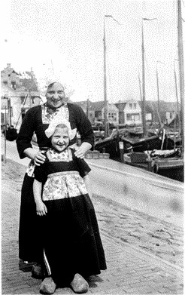
This photograph of Irma and Ursula was taken in the 1930s, and shows them on holiday in the Netherlands.
A German-Jewish family, the Klipsteins managed to escape Germany and find refuge in Belgium.
In 1942 they went into hiding with a non-Jewish family in a suburb of Brussels. The family was denounced to the Gestapo in 1943, and Irma and her husband Leo were arrested.
Ursula was not arrested as she was assumed to be the daughter of a Christian family.
Irma and Leo survived the war.
The family were reunited at the end of the war and migrated to the USA in 1947. The Klipstein story touches on a number of important themes, including escape and rescue, betrayal and hiding, and the rebuilding of family life after the Holocaust.
Irma Klipstein and her daughter Ursula taken on a visit to Volendam, Netherlands.

Slide 2
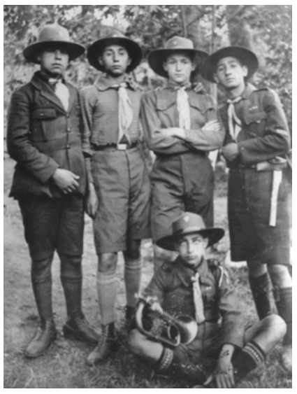
Among those pictured is Samuel Rouben. During the war, Samuel was due to be transported to Auschwitz from Greece with his wife, but they managed to escape from the transit camp.
They drove to the Italian consulate where they were given papers and train tickets to Athens.
They then hid with a Greek Orthodox priest for the final two years of the war.
Samuel’s story draws our attention to the geographical scale of the Holocaust, whilst also raising issues of aid and rescue.

Slide 3
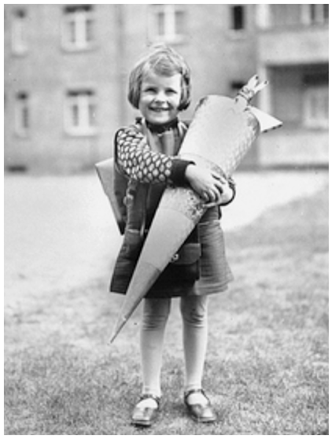
Berta Rosenhein, Leipzig.
Berta Rosenhein is shown here holding her “Schultüte” – school cone – in 1929. The cone is full of sweets, and was (and still is) traditionally given to all children on their first day of school in Germany.
In its own small way this photograph is an indication of the thorough integration of the Jewish community into German society in the early twentieth century.
Berta came to Britain as a teenager in 1939, as one of the almost 10,000 unaccompanied children rescued through the Kindertransport programme.
She lived with a family in Bromley. Berta’s mother Irma was deported to Riga and murdered in 1943. After the war, Berta migrated to New York.

Slide 4
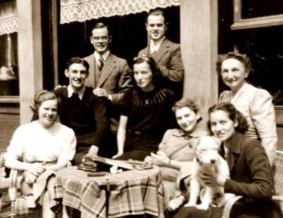
The Jacobsthals were a German-Jewish family who moved to the Netherlands in 1929.
Hilde is seated in the lower-right corner. When the Nazis began to deport Jews from Amsterdam in 1942, Hilde worked in the crèche where Jewish children were held prior to deportation and helped to organise their rescue.
After her parents were deported in 1943, she escaped and joined the resistance movement in Belgium.
At the end of the war Hilde went to work with the Red Cross at Bergen-Belsen. She later married a Swiss doctor, migrating first to Israel and then moving to the USA in 1950.
The Jacobsthal family outside a café, Amsterdam.

Slide 5
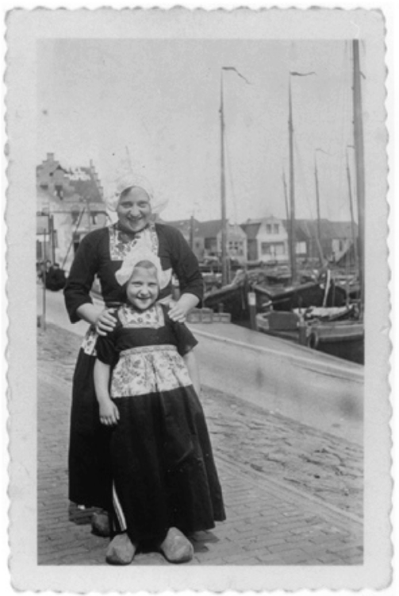
What nationality do you think these people are?
Apart from their nationality is there any other reason that they might be dressed like this?
(Think about when you might wear costumes.)
Can you work out anything else about them from this picture?

Slide 6
Which organisation do you think these boys belong to?
What kind of activities do you think they enjoy?
Use the photograph to help you.
Is there anything else you can say about these boys’ lives?
(Think about their nationality, religion and family life.)

Slide 7
This girl is holding a large cone full of sweets to mark a special occasion.
What do you think that the special event is?
(Look very carefully at the photograph for extra clues.) How do you think that she feels about this event?
Can you make any decision about her religion or nationality from the photograph?

Slide 8
Where do you think that this photograph was taken?
(Look at the background to give you clues.)
What can you tell about these people from this picture?
(e.g. nationality, religion, other interests)
Do you think that these people are family or friends?
Do you have similar photos at home?

