Slide 1



Individual Investigation
Amcan: to have collated several possible titles for your project.
Learning Outcomes
Understand what the individual project is about.
List all the possible topics you could use for your project.
Finalise a possible title.

Slide 2



Teaching and learning
(40 hours)
Assessment (80 hours in class and out)
Content
The production of a written project of 3,000 – 5,000 words in length or an artefact/product supported by written evidence 1,500 – 3,000 words. It must go on the front of your project. DO NOT count bibliography and appendix.
Artefact will need a written report and a production record (e.g. log book and scrap book/mood board etc.). It needs to show how you go from idea to getting the product made.
Written work should be word processed and include a variety of graphs, images, statistical tables, diagrams and drawings.

Slide 3
Artefact
You must produce a finished artefact that is of a high standard. The conclusion should include a detailed evaluation of the artefact and its fitness for purpose. You should be encouraged to incorporate how you will measure the success of their artefact after they have created it.
If the artefact is 3D then high quality photographic evidence of the artefact should be included in the your work, the actual artefact does not have to be sent for moderation.

Slide 4
Process not Product
You are assessed on your INVESTIGATION SKILLS not just your knowledge and understanding of the issue.
I need to see a clear train of thought:
  I want to find out this
  This is how I am going to do it and why
  These are the sources I found
  I know these are reliable because
  From this, I learned
  This told me that
  If I did this again I would

Slide 5
IN SECTIONS
  I want to find out this – AIMS & OBJECTIVES
  This is how I am going to do it and why - RATIONALE
  These are the sources I found – FINDING SOURCES
  I know these are reliable because – EVALUATION OF SOURCES
  From this, I learned SYNTHESIS & PRESENTATION
  This told me that - CONCLUSION
  If I did this again I would - EVALUATION

Slide 6

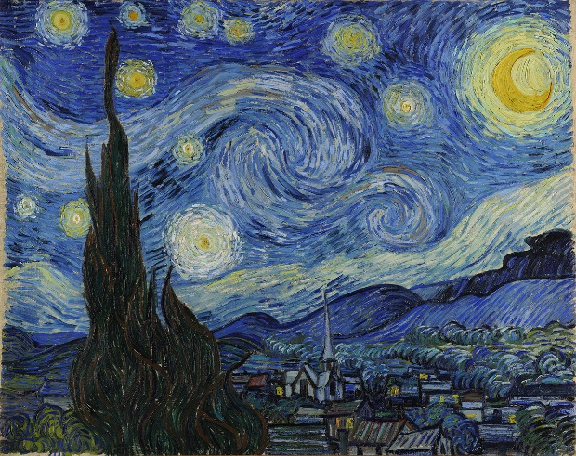
Topic
You must explore an area that reflects your future educational or career aspirations but is underpinned by research.
A variety of Project Proposals which have been produced by Higher Education departments and organisations will be available on WJEC website.
http://www.wjec.co.uk/qualifications/welsh-baccalaureate/welsh-bacc-from-2015/Advanced/
It is advisable for learners to keep a research diary/log. In this they can record:
^{• Their planning}
^{• Information and ideas}
^{• How their Project develops}
• Why they have taken decisions
• Reflection for discussions with subject staff and from one to one
• Review the process of the Project as they carry it out.

Slide 7

Mind map all your ideas
Future career/aspiration
Politics
BREXIT

Slide 8
The Office of National Statistics
https://www.ons.gov.uk/
When deciding on a topic please use this website. It will help you decide if it is suitable as it will show whether there is a lot of data based on your topic. You will need to collect primary and secondary data to be able to reach higher bands for Numeracy.

Slide 9
The Office of National Statistics
To use the ONS please follow the instructions.
Go to https://www.ons.gov.uk/
Search for key words at the top of the home page such as ‘robbery’
On the left hand side of the new page select data sets
  Does this give you enough data to work with? If no results then it is not a suitable topic
if data does appear click on a title that comes up e.g. Nature of crime: robbery
Scroll down to the Excel document. This will give you a lot of data – look through the tabs at the bottom of the page. You can use this for secondary information in your investigation.

Slide 10
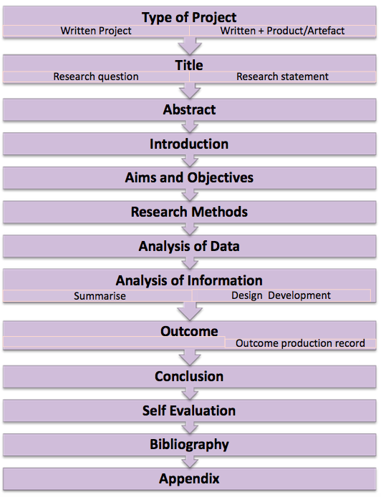
A clear structure to the Individual Project is essential for its success. It ensures that there is evidence for all the required learning outcomes that contribute to the assessment. Clearly labelled sections should be evident.
Each of you will be given 1 to 1 sessions throughout with your Skills teachers to track progress. The first will be to finalise your title, aims and objectives.

Slide 11
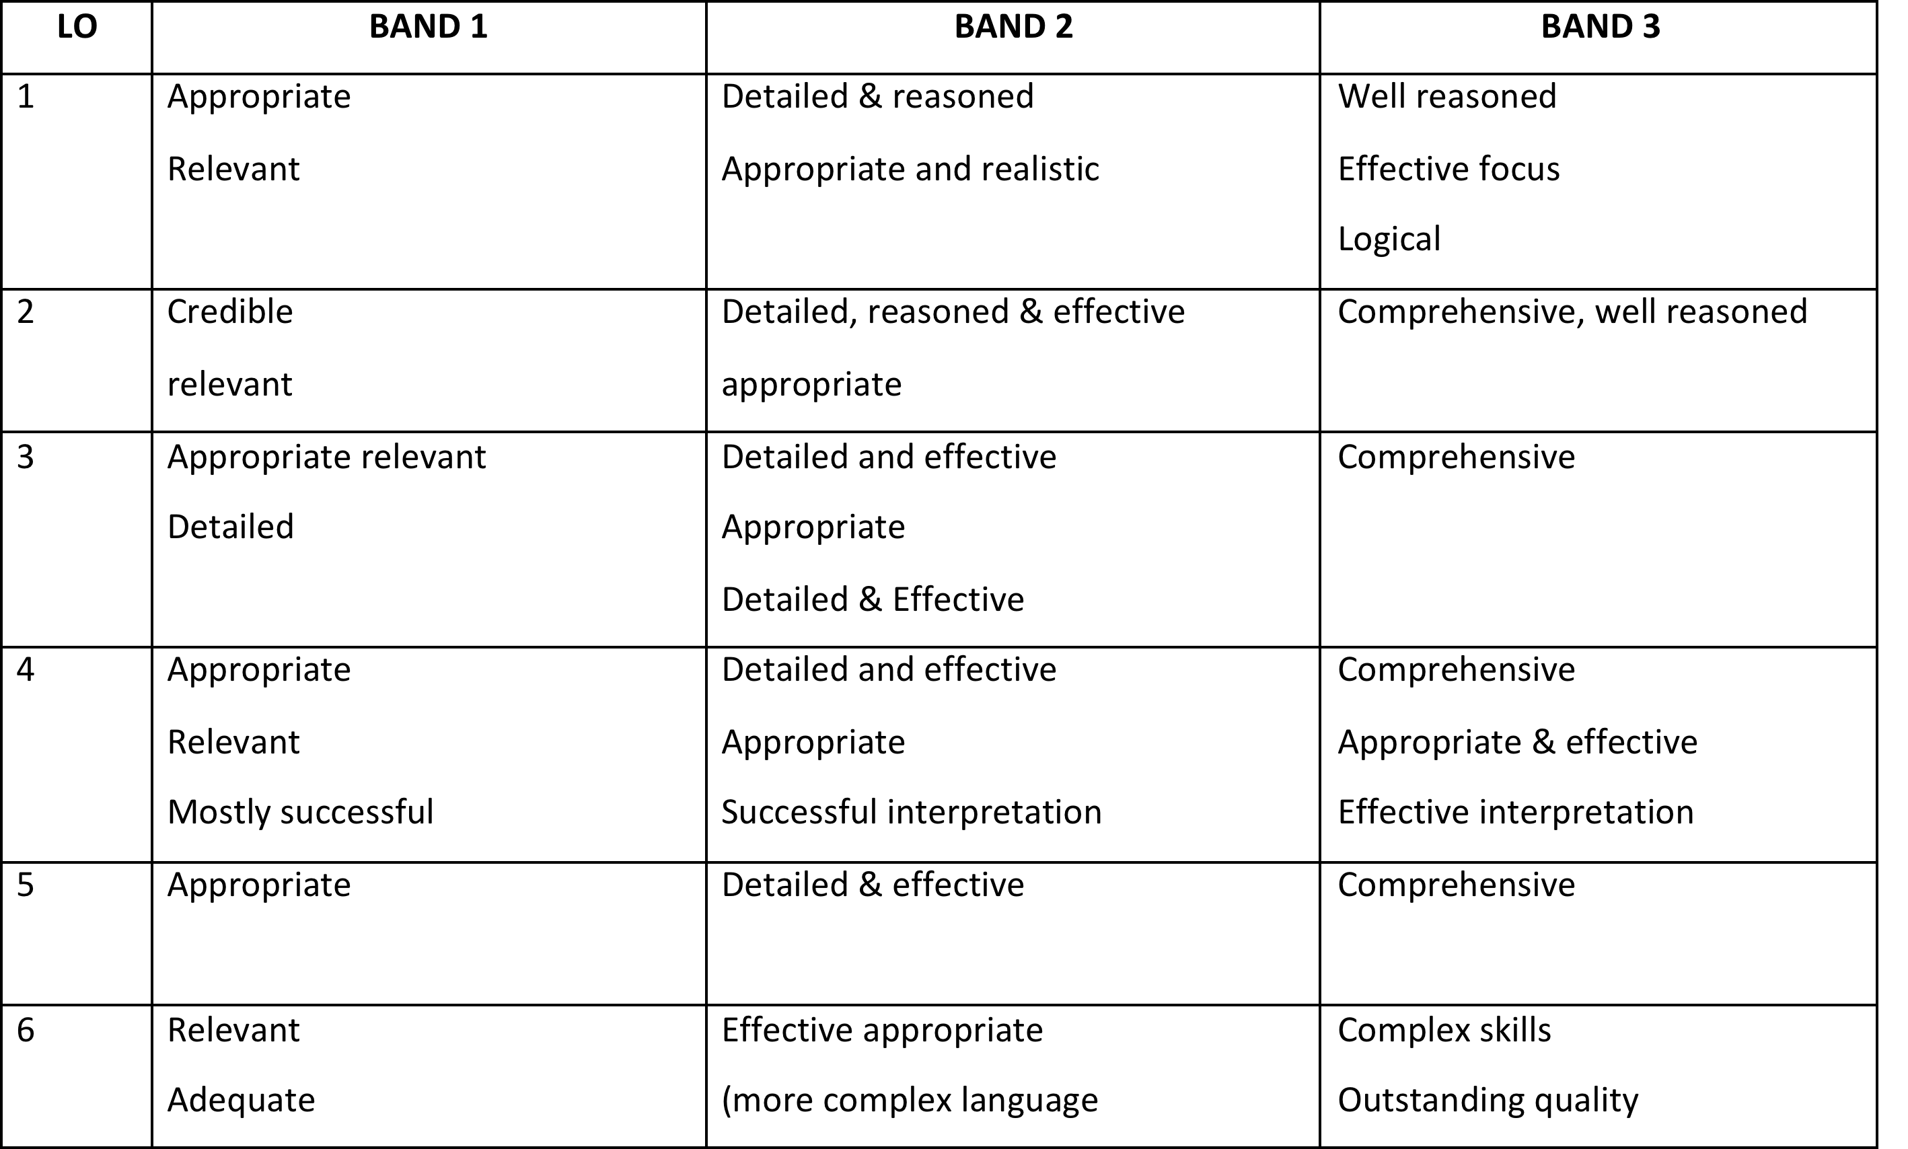
Grade Descriptors

Slide 12


Title – best ones are questions or hypothesis
The title should lead to an Individual Project having clear intent, being manageable and focused.
You could be creative in how you title your project. The introduction, aims and objectives would address the clear intent and focus of the project, for example:
1) Energy or Green energy?
This would be a project which researches the pros and cons of future energy in Wales - should we be considering non-renewable energy (nuclear) or sustainable energy (tidal).
2) Is being social making us more antisocial?
This could be a project on the use of social media for cyber-bullying, comparing the problems faced in Wales and another region. Alternatively, it could be a project on how teenager's social skills are being affected as a result of the age of social media.

Slide 13
Using all your possible topics of interest. Now try to focus on an area and come up with possible titles. These titles need to be a question that you want answered.
Future career/aspiration
Possible title
Remember to hand your questions in to your teachers to make sure if they are suitable.
*highlight your possible final choice.

Slide 14

Individual Investigation
Amcan: to have collated several possible titles for your project.
Learning Outcomes
Understand what the individual project is about.
List all the possible topics you could use for your project.
Finalise a possible title.

Slide 15


Introduce yourself in less than 30 words.
What do you think should be included in your investigation introduction?

Slide 16
Introduction Writing
Amcan: write a draft introduction to your project.
Learning Outcomes
Write about yourself in 30 words.
List what you should include in your introduction.
Draft the introduction to your project.

Slide 17
Introduction
Your introduction for your project should set the background and purpose of your work.
There should be a personal explanation as to why you have chosen your title; that it is an area of interest following previous learning, a topic related to future ambition, or could be very relevant to today's society.
You should put the project title into context, with an overview to the topic you will be researching and any conclusions they expect to make.

Slide 18
What is the background and purpose of your work?
Why have you picked this topic?
Focus and Scope
What do you think you will find?**
Title
Question
Please write about the following questions
Introduction
** you will need a hypothesis – statements that can be tested
e.g. Title question – Why do differences in GCSE results exist between the sexes?
We answer the research question using hypothesis e.g. for varying education ability at GCSE between the sexes
H1) Males do worse than females at GCSE English
H2) Females revise for longer than males

Slide 19
Draft your introduction. Note the focus and scope.
Remember your SPaG!
PURPLE PENS:
Swap your work with a partner, so they can peer assess.
WWW:
EBI:
Check SPaG
Now make corrections!

Slide 20
Starter
Write down something you want to achieve in life and what you need to do to achieve it.

Slide 21
Aims and Objectives
Amcan: explain the difference between an aim and an objective
Learning Outcomes
Write your own ambition and explain how you will get there.
Describe the difference between an aim and an objective.
Design your own aims and the objectives to reach the aim.

Slide 22
Moderators feedback
Aims and objectives were a weakness of last years investigations.
To improve on this you must
Use action verbs
Not confuse objectives with your rationale

Slide 23
Explanation
What you wrote down first was an aim – it is something you want to achieve in the long term.
Business aim- to survive financially
The next steps you wrote down are objectives – they are targets you will need to achieve so that you can achieve your aim.
Business objective – to increase income by 15% each month.

Slide 24

Aims and objectives
3 aims are expected with 2 or 3 objectives for each;
Numbering the aims and objectives is helpful as they can be referred to later in the project.
Aims are general statements describing what you hope to accomplish. They should be written in order to answer the research question or to full fill the research statement.
Objectives are specific statements that are about actions which explain the outcomes of the steps of how the learner is going to go about the project. They are a list of tasks which should be practical, measurable and achievable. The objectives define the structure of the project.

Slide 25
Objectives must be…
SMART
Specific
Measurable
Agreed
Realistic
Timed

Slide 26
Layouts To Use
AIMS | OBJECTIVES
AIM 1 | Obj 1a
 | Obj 1b
AIM 2 | Obj 2a
 | Obj 2b
AIM 3 | Obj 3a
 | Obj 3b
AIMS
  1)
    Objective a)
    Objective b)
  2)
  a)
  b)
  c)
  3)
  a)
  b)
You MUST refer to these throughout your project. When writing your research please give a sub heading of each aim.

Slide 27
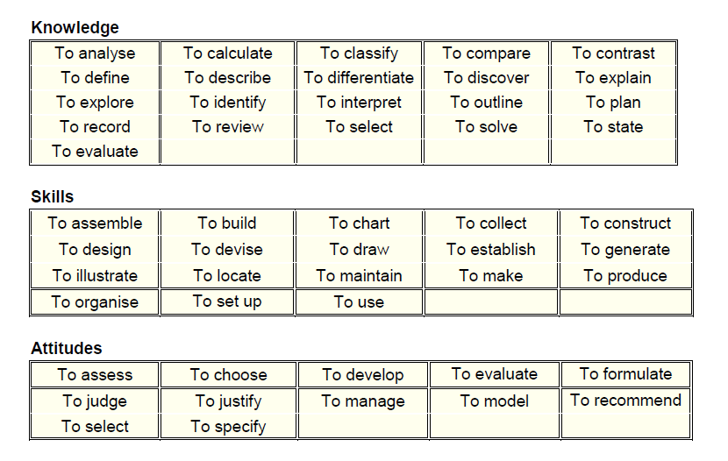
Suitable action verbs that you must use when writing aims and objectives are
e.g.
Aim 1: To explore teachers opinion on the importance of teaching the Welsh language
Objective a: To record teachers answers
Objective b: to analyse results
Remember!!!
You do not need to state how you will record answers in your objectives – this will be done in your rationale.

Slide 28
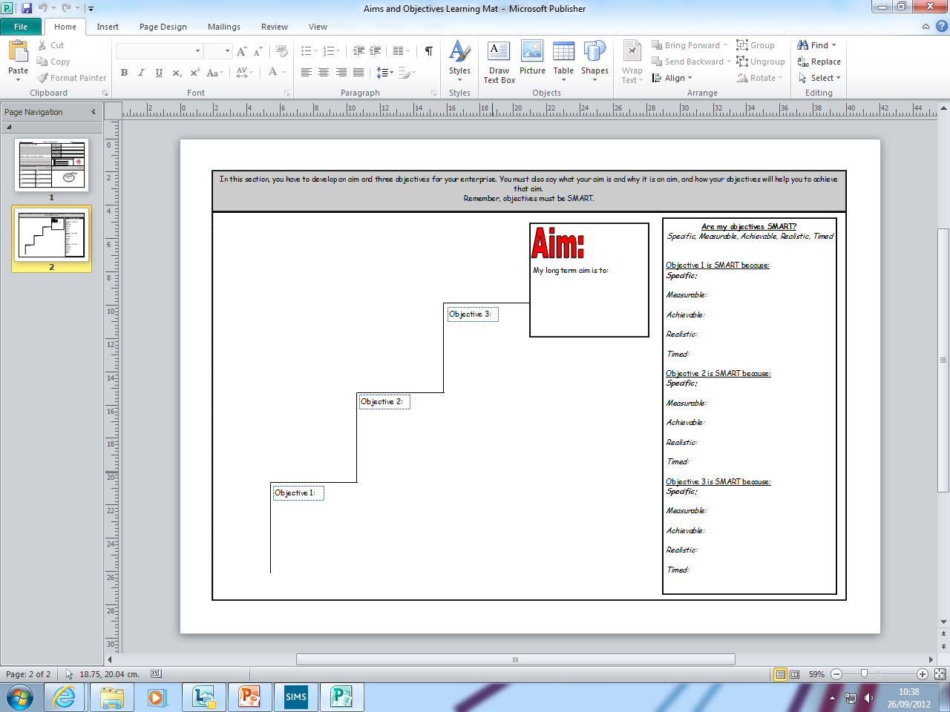
Example
To help young people become successful learners and healthy, confident individuals.
To gain 97% average attendance by September 2016.
To achieve 60% 5 A*-C (including English and Maths) by August 2016.
To offer a range of subjects suitable for all learners wants, needs and interests by September 2016.

Slide 29
How to get Band 3 LO1
DETAILED & LOGICAL & REALISTIC (if you walked out the door and dropped the first three pages on the floor, could I complete your investigation for you?)
Objectives link to Aims which links to Title and vice versa
Effective

Slide 30



Task
Develop aims and objectives for your investigation using the staircase.
Remember, your objectives must be SMART

Slide 31

List 3 ways that you are able to
find information

Slide 32

Research Methods
Amcan: explain how to write the rationale for your project
Learning Outcomes
List ways to find information.
Describe what is meant by rationale.
Draft the rationale for completing your objectives and therefore your aims.

Slide 33
Rationale – what is it?
A rationale is a reason or logic behind your decisions. It’s not a description.
Don’t just say what you’re going to do – explain why you’re doing it, referring back to your aims and objectives.
Rationales should provide a road map to audiences that sets certain goals that you want to achieve, and how you plan to meet those goals.
Describe appropriate research methods
Explain why you have chosen them

Slide 34
You are encouraged to write rationale statements with the assumption that the people reading your statements will be unfamiliar with your work i.e. it must be easy to understand and follow.
A rationale is a statement that justifies your reasons for a particular proposal.
Your rationale should be brief yet also adequately descriptive to summarize your intended activity and the potential challenges and outcomes.

Slide 35
How to get a BAND 3– AC1.2
DEPTH & BREADTH (Broad)
Consider:
  Interviews
  Books – use Google Books
  Internet
    Blogs
    Research papers
    Government websites
    Charity websites
  Questionnaire – explain different types of question you will use – open and closed, the potential dangers of ‘leading questions’, who is your target group/ sample, do a pilot to test your first questionnaire
Pass- Internet (secondary research) and Questionnaire (primary research)
To aim for merit/distinction you must have all 4 – internet, questionnaire, books and interview.

Slide 36
Rationale
Internet
Questionnaires
HOW are you going to find this out
WHY have you chosen this method
WHAT are the strengths of this method and what are the possible shortcomings?
Interviews
Aim 1
This research will answer aim 1 by conducting a questionnaire that will be given to every teacher in the school. A questionnaire is best suited to this aim because… It was chosen as it is a fast way of collecting data. The shortcomings are…
AIMS | OBJECTIVES
AIM 1 | Obj a
 | Obj b
AIM 2 | Obj a
 | Obj b
AIM 3 | Obj a
 | Obj b
You should be writing at least 1/3 page of rationale for each objective

Slide 37
PURPLE PENS:
Swap your work with a partner, so they can peer assess.
WWW:
EBI:
Check SPaG
Draft your rationale.
Remember your SPaG!
Now make corrections!

Slide 38

Spot the difference
What are the differences between these question
Are you : Male Female
What is your opinion on the food in the bwyty? ______________________________________________________________________________________________________________
Rate the food in the bwyty (1-awful 4- excellent)
1 2 3 4

Slide 39
Primary research
Amcan: explain how to write good questionnaires to gain clear information about your project.
Learning Outcomes
Describe the difference between primary and secondary research.
Explain how to plan a questionnaire.
Describe the difference between open and closed questions and how they can expand your data collection.

Slide 40
Information
Primary data
Researchers are collecting information for the specific purposes of their study.
The questions you ask are tailored to produce data that will help with your study. You collect the data, using e.g. surveys and interviews.
E.g.
Part of the research may involve interviewing workers by telephone or face to face. The answers will provide you with specific information about the topic.
Secondary data
There are several types of secondary data. The reliability, authenticity and generalizability of secondary data is less as compared to primary data as it has been already manipulated and used by other people.
Compared to primary data, secondary data tends to be readily available and inexpensive to obtain. What’s more many types of secondary data are collected over a long period. That allows researchers to detect change over time.
You are able to find secondary data in books, journals and websites.

Slide 41

Numbers – Quantitative data
Questionnaires
The analysis of quantitative data involves examining the data collected in ways that reveal patterns, trends, relationships, etc. that can be found within it.
Whilst analysing data you should make use of suitable statistical methods such as:
Collate data using tallying, grouping etc.
Display data using tables, charts, diagrams or graphs
Determine if there is a link between two measurements – scatter diagram, line of best fit, correlation
Use ICT to do the calculations and display data;
Interpret what the data suggests. Does it answer the question?

Slide 42

Steps to a Successful Survey/Questionnaire
Step 1 – What do you want to know?
Step 2 – Who is the audience?
Step 3 - Audience + Purpose = Design
Step 4 – Pilot survey
Step 5 – Gather Information
Step 6 - How will this information be used?
Step 7 - Celebrating your success.

Slide 43

STEP 1 What do you want to know?
Be clear about the goal of the questionnaire.
What will it achieve?
What do you want to find out?
What information do you require - Opinions, Preferences,
Ideas, Priorities, etc?

Slide 44

STEP 2 – Who is the audience?
How are you going to use the questionnaire?
Identify who should be interviewed.
How will you select the sample?
How big should the sample be?

Slide 45

Now you know the Audience + Purpose you can design the questions

Slide 46
Types of Questions
Two important aspects are structure of the questions
and the types of response formats for each question.
Can you think of examples of open and closed questions?
Closed
Open

Slide 47
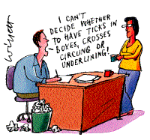
Closed (or multiple choice) questions
Respondent can choose an option given to them - asked to tick or circle the chosen answer.
These questions provide data which is easy to present in the form of a chart, graph or table. i.e you can count the answers!

Slide 48
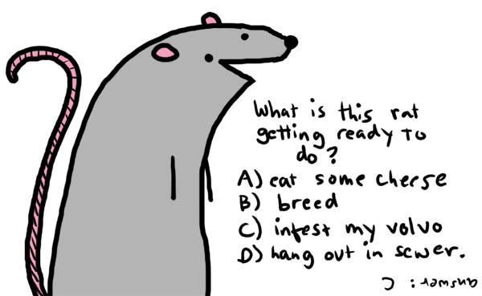
Multiple Choice questions
Which of these shops do you prefer?
Next / River Island / Top Shop / Primark

Slide 49

Number scales
Make sure categories do not overlap, they
must be mutually exclusive.
1. How old are you?
Under 20 20 – 30 31 – 40 41 – 50 51 – 60 61 or more
2. How often do you watch TV on a typical day?
Less than 1 hour 1 – 3 hours more than 3 hours

Slide 50

Rank order
Please indicate, in rank order, your preferred
chocolate bar, putting 1 next to your favourite
through to 5 for your least favourite.
Double Decker ……..
Crunchie ……..
Wispa ……..
Mars Bar ……..
Creme Egg ……..

Slide 51


Agreement scale
4 options ensure a choice is made, with 5
options many choose the middle.
How much do you agree with the following
statement?
Assessment by coursework is easier than
assessment by examination.
Strongly agree Agree Disagree Strongly disagree
Having 5 options will allow the respondent to give neutral answers which you want to avoid. This will not give you any valuable information.

Slide 52
Rating scale
1. How would you rate this product?
Excellent Good Fair Poor
2. On a scale of 1 to 4 where 1 is not interested at all and 5 is very interested.
How interested are you in using this exhibit in an
exhibition?
1 2 3 4

Slide 53
Fit for purpose questions? Why?
How is your health in general?
Very good
Good
Fair
Bad
Very bad
Which of these qualifications do you have?
1-4 GCSEs
NVQ level 1
5+ GCSEs
Degree
Apprenticeship
NVQ level 2
Foreign qualifications
Professional qualifications
2+ A levels
No qualifications
What is your religion?
This question is voluntary
No religion
Christian
Buddhist
Hindu
Jewish
Muslim
Sikh
Any other religions
How well can you speak English?
Very well Well Not well Not at all

Slide 54
REMEMBER YOUR HYPOTHESIS
e.g.
H1) Males do worse than females at GCSE English
Q1. Are you male or female?
Q2. What was your final result for GCSE English?
These questions are able to test our hypothesis and help answer our overall question.

Slide 55

In your books come up with 3 different types of closed questions that would give an opinion on a chocolate bar

Slide 56

Open-ended questions
Respondents answer in their own words.
These questions can be difficult to analyse – you can’t count them but you can quote them in your work
Should be at the end of the questionnaire.

Slide 57

What are your favourite TV programmes and why?
(Please specify their titles)
. . . . . . . . . . . . . . . . . . . . . . . . . . . . . . . . . . . . . . . . . . . . . . .
. . . . . . . . . . . . . . . . . . . . . . . . . . . . . . . . . . . . . . . . . . . . . . .
. . . . . . . . . . . . . . . . . . . . . . . . . . . . . . . . . . . . . . . . . . . . . . .
What do you think are the main causes of racism?
. . . . . . . . . . . . . . . . . . . . . . . . . . . . . . . . . . . . . . . . . . . . . . .
. . . . . . . . . . . . . . . . . . . . . . . . . . . . . . . . . . . . . . . . . . . . . . .
. . . . . . . . . . . . . . . . . . . . . . . . . . . . . . . . . . . . . . . . . . . . . . .
Answer these questions.
Be prepared to feedback to the class.

Slide 58

Draft your questionnaire.
Once you have drafted your questionnaire you will need to carry out a pilot in class.
Get some pupils in the class to try and complete it.
Are the instructions clear and were the questions
understood?
Are there other options?
Are the answers what you expected and do they give appropriate information?
Can the responses be presented as charts, graphs
and tables?
Do you need to modify the questionnaire?

Slide 59

HOMEWORK
Complete the final draft of your questionnaire and gather your research.
You must have at least 30 filled in questionnaires.
**To help your digital literacy marks you may want to consider using Survey
Monkey instead of having paper copies

Slide 60
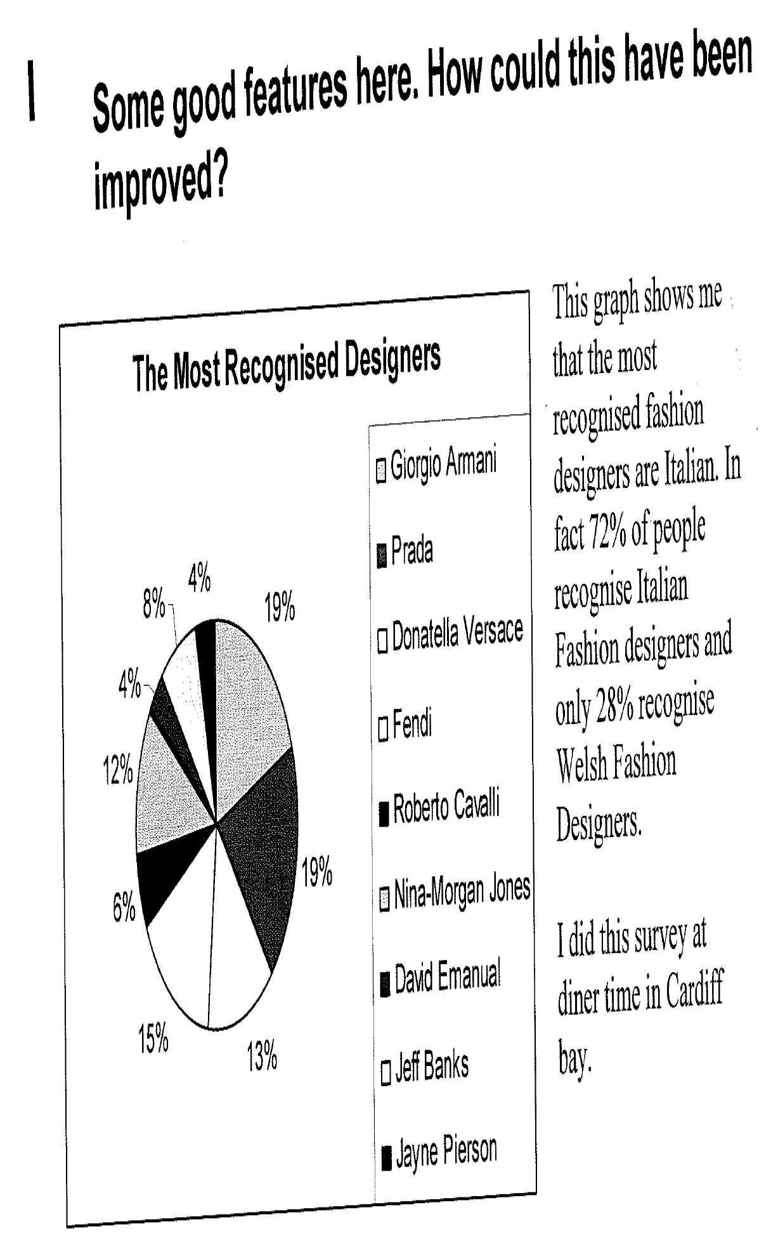
Why do you think this?

Slide 61
Data
Amcan: to decide the most appropriate way to show data
Learning Outcomes

Slide 62
Task: Merit/ Distinction
From marking feedback it was found that not enough data analysis was done and this was seen as one of the weakest parts of the investigation in general.
To gain a merit or distinction you must use more than a graph and pie chart.
In pairs match the graphs up with the descriptions.

Slide 63
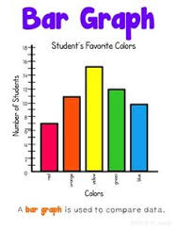
Bar graph
These are used to compare facts. They provide a visual display for comparing quantities in different categories or groups. They are used for discrete data. They help us to see relationships quickly. However, they can be difficult to read accurately. A change in scale may alter the visual perception of the data.

Slide 64
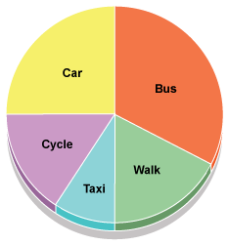
Pie chart
These are used to compare the parts of a whole. They are best used for displaying one set of data. If the values of the parts are quite similar they can be difficult to read and understand.

Slide 65
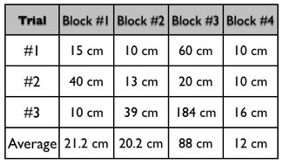
Table – everyone must include a table
These are used to organise exact amounts of data and to display numerical information. They do not show visual comparisons. As a result, they can take longer to read and understand. It can also be difficult to examine overall trends and make comparisons.

Slide 66
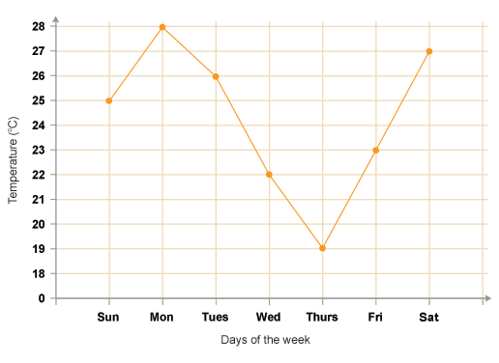
Line graph
These are used to display data or information that changes continuously over time. They allow us to see overall trens as an increase or decrease in data over time.

Slide 67
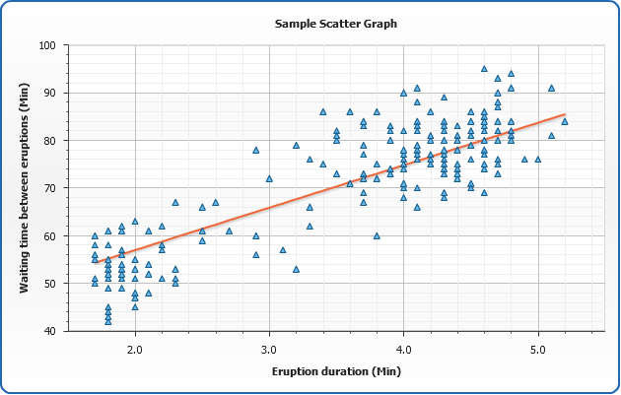
Scatter graph
These graphs are drawn to find patterns in sets of data (if present). They show the relationship of one variable to another. The relationship between the two variables is called their correlation. A line of best fit is drawn through the data to show correlation.

Slide 68
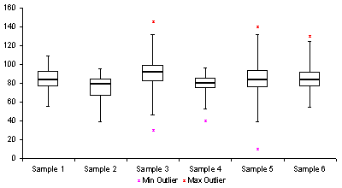
Box and Whisker
This is used to display information about the range, the median and the quartiles. It is usually drawn alongside a number line.

Slide 69
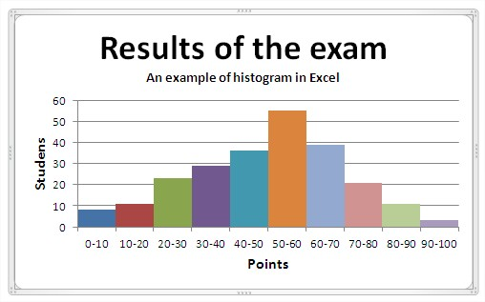
Histogram
With these graphs the data represents continuous rather than discrete categories. However, because a continuous category may have a large number of possible values, the data is often grouped to reduce the number of data points. For example, instead of drawing a bar for each individual age between 0 and 65, the data could be grouped into a series of continuous age ranges such as 16-24, 25-34, 35-44 etc.
The area of the bar is proportional to the size of the category represented and not just its height.

Slide 70
Appendices
Please include further data in your appendices.
This can be a table showing overall results to questionnaires etc.
You may only decide to show 2 out of 10 question results in your essay so be sure to show all other results as e.g. Appendix A.
This will help towards your numeracy marks.

Slide 71
Check list
Have you completed the survey?
Have you recorded results in a spreadsheet?
Have you collated responses using tally charts?
Have you included a copy of the spreadsheet
in the appendix of the investigation?

Slide 72
Secondary Research
Feedback from the WJEC states that they would like to see quantitative and qualitative secondary data too.
Data e.g graphs, tables
Reading texts
The Office for National Statistics will provide you with a lot of data
https://www.ons.gov.uk/
Once you have learned how to reference please use this website for data.

Slide 73
What is plagiarism?
Try to define plagiarism

Slide 74
Secondary Research
Amcan:
Learning Outcomes

Slide 75
Information – Qualitative (descriptive)
The analysis of qualitative information should be a creative and critical process. Whilst analysing information, you should:
Show detailed knowledge and understanding of the project title, with reference to information collected from primary and secondary sources;
Recognise the importance of accuracy, relevance and reliability of information to the analysis process;
Aim to summarise all relevant information that has been collected; recognising similar and different viewpoints.

Slide 76

Plagiarism
If you copy a piece of writing from someone else and present it as being your own work, this is called plagiarism.
If your Individual Investigation includes work copied from someone else and you have not properly acknowledged or referenced it, you will fail.
From the website of Austin Community College Library.austincc.edu/gen-info/facplagiarism.htm

Slide 77

Using the internet
You must remember that it is important to acknowledge information you find on the internet in the same way as other sources and not just cut and paste it into your work.
The same is true if a writer wants to use an image from a website.
http://images.businessweek.com/ss/07/03/
0311_techcheats/source/2.htm

Slide 78

The same is true of copying another person's ideas or other creative work.
Even if you get permission you must always acknowledge the source of your information.
www.fotosearch.com

Slide 79
Do you have to provide references for every fact you use?
Obvious facts readily available from numerous sources and generally known to the public are considered "common knowledge."
They are not protected by copyright laws so do not have to be referenced.
e.g. ‘The President of the United States is
Barak Obama.’

Slide 80

How are sources usually referenced or cited?
As you go along e.g. following each quote used
In footnotes (Vancouver referencing)
In a bibliography
Always put quotes in quotation marks. This marks them as not your own words.

Slide 81

How can footnotes be used to reference sources?
Footnotes are written at the bottom of a page
Numbers placed at the end of the information, quote or source used in the main text are used to show references.
Footnote here

Slide 82
You must reference information that is taken word for word from another source. Here is an example of a footnote.
‘The inauguration of Barack Obama as the
44th President, and Joe Biden as Vice
President, took place on January 20,
2009.’ 1
1. FromWikipedia:
http://en.wikipedia.org/wiki/Barack_Obama

Slide 83
Footnotes
Once you have used a piece of information that isn’t your own please follow the instructions to footnote the work. (You do not need footnotes if you are using Harvard Referencing.
Note the secondary information
Go to References tab at the top of the document
Select insert footnote which will then put a number next to the information
Go to the bottom of the page where you will find the matching number – put website link or book here

Slide 84
Provide references when you…
Use any facts, statistics, graphs, drawings—any pieces of information—that are not common knowledge;
Use another person’s idea, opinion, or theory;
Use quotations of another person’s actual spoken or written words; or
Paraphrase another person’s spoken or written words.

Slide 85

Is this plagiarism?
If you were to see this in a friend’s work without references ,
what sentences do you believe have been plagiarised.
The world is round.
Float like a butterfly, sting like a bee.
Maybe Christmas, the Grinch thought, doesn't come from a store.
Gravity gives weight to physical objects.
China has the worlds biggest population.
Piglet noticed that even though he had a very small heart it could hold a rather large amount of gratitude.

Slide 86
Harvard referencing CITING SOURCES
Citations: refer in your text to the sources used. Citations are found in the body of the text.
The following sentence could be used in your investigation where you refer to ideas by Professor David Crouch.
‘It has been suggested that the medieval tournament resembled …a modern spectator sport, with spectators, chants, national teams, team colours, inflated salaries, transfer fees, celebrity cults and a lifestyle notable for its excesses.’ (Crouch, 2006, p.13)
Alternatively you could begin,
‘Crouch (2006, p.13) has suggested…
Author’s name & date

Slide 87

Cite when paraphrasing
Paraphrasing is rewriting an argument, opinion or point made in a source using your own words.
If you are paraphrasing a particular argument or point made in a source you must acknowledge the source of your information and include page numbers.
It has been argued (Harris 2001) that……….......

Slide 88

Using direct quotations
Use quotation marks and include the page number.
If there are more than two authors, cite only the first followed by ‘et al’ which means and others.
“….homeless in Cardiff.” (Smith 2011)
“....homeless in Cheyenne” (Lewis et al. 2011)

Slide 89

Internet sources
Author and/or organisation | Publication Date | Title and format of document | Available at (Web address) | Date accessed
Chris Mcgreal, Guardian Online | 16 February, 2012 | Congress passes payroll tax cut as GOP relents on savings demand. Online. | http://www.guardian.co.uk/world/2012/feb/15/us-congress-payroll-tax-cut | 17 February, 2012
Chris McGreal. Congress passes payroll tax cut. 16 February 2012. Available at: http://www.guardian.co.uk/world/2012/feb/15/us-congress-payroll-tax-cut. [Accessed 17 February 2012]

Slide 90
The Office for National Statistics
https://www.ons.gov.uk/
Search for key words from your investigation in the search bar
On the right hand side click data sets
Pick a topic that suits your investigation
Download the xls spreadsheet for data.
Click on tabs on the bottom of the spreadsheet to find data.

Slide 91
Remember - Presentation
For a project with or without an artefact you should show an efficient and effective use of a range of appropriate Digital Literacy skills and techniques in producing and presenting the written outcome of your project.
You should incorporate tables, charts, diagrams, graphs and images.

Slide 92
Product/artefact outcome
You must keep a Development Record of how the artefact has been designed and produced.
A copy of the final design should be included with some explanation of why the design has been chosen. You must capture how you have produced the artefact and include evidence of any practical skills you have developed in preparation for the production of the artefact.
Good practice would be to include a narrated video of the final outcome rather than one photo. The Development Record can be presented in any visual form e.g. a scrapbook, Prezi etc

Slide 93
Product/artefact outcome
The Development Record could also include the following evidence:
A detailed action plan for the development of the artefact;
Pictures or videos of every stage of artefact development;
Visual, audio or written diary documenting the development of the artefact;
Explanation, critical analysis and evaluation of each stage of production;
Feedback from tutors or peers during artefact production, with reflection and amended action points as a result.

Slide 94

Nearly there…

Slide 95
Conclusion
The conclusion must be based on the evidence used within the research. You should use a reflective approach showing how the stages are connected to give a convincing answer to the research question or statement in the title.
Consider:
What did the evidence show in relation to the aims? Please refer to the aims when writing the conclusion.
Were the aims met, did they go beyond them, or in fact fail to reach the aims?
Was the research question or research statement answered or completed?
Was the artefact fit for purpose?

Slide 96
Self-Evaluation
This is the opportunity for you to consider your own progress.
You must consider your strengths and your pitfalls in carrying out your project by reflecting on your skill set and performance.
Further to this you must evaluate every learning objective from the marking criteria. Your teacher will share this with you. There are 8 to evaluate. You must mention when you used the certain skill.

Slide 97
Bibliography
The bibliography should include a list of all of the sources used in the process of researching the project. An annotated bibliography also includes a brief description of the content, quality and usefulness of the source.
This should be done every time you use a new source. Do not leave it until the end, you may forget where you found your information.

Slide 98
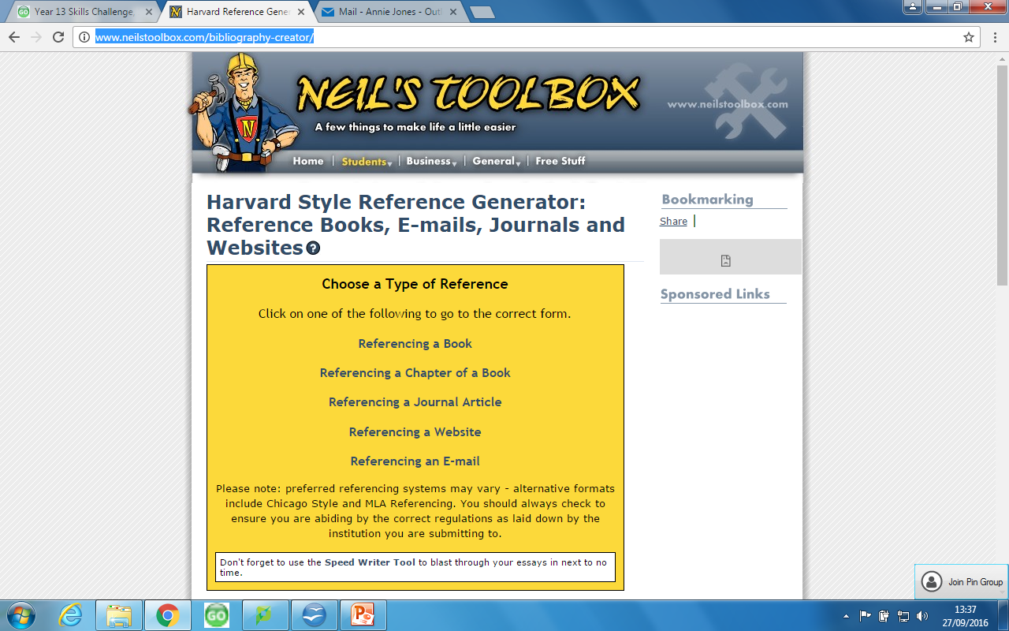
The Bibliography if using Harvard referencing
In general, a bibliography should include:
  the authors' names
  the titles of the book/journal/article
  the names and locations of the companies that published your copies of the sources
  the dates your copies were published
  Neil’s tool box will help you with this
  http://www.neilstoolbox.com/bibliography-creator/
schol.wordpress.com
Harvard referencing tutorial: https://xerte.Cardiff.ac.uk/play_4191

Slide 99
How to format your bibliography
Footnote (number order from essay)
Vancouver referencing
Harvard (alphabetical order from essay)
www.google.co.uk
www.wjec.co.uk
3. www.thetelegraph.co.uk
Davies,L. (2016)
Jones,A. (2006)
Rhys Jones, R. (1998)

Slide 100
Appendix
Pictures of artefact
Log book of artefact
Notes on artefact
The appendix should include information that supports the project.
One clean copy of any questionnaire that has been used (not completed questionnaires)
the transcript of any interview carried out
record sheet of any observations
any calculations carried out
Results of questionnaire etc.
The analysis and interpretation of any information and numerical data must fall in the main body of the project.

Slide 101
Abstract - no more than 200 words
To be written after you’ve completed your investigation HOWEVER to be placed before your introduction.
An abstract is to outline the aims of your investigation.
Why you’re doing it
How you will find your information
Your overall conclusion.

