Slide 1
Can Ghana trade its way out of poverty?
How your choices make a difference

Slide 2
From what you know about Ghana..
What resources has it got that it could sell?
Why has trading not helped Ghana in the past?

Slide 3
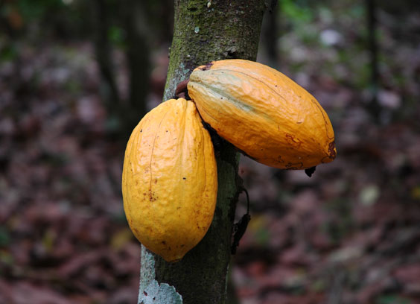
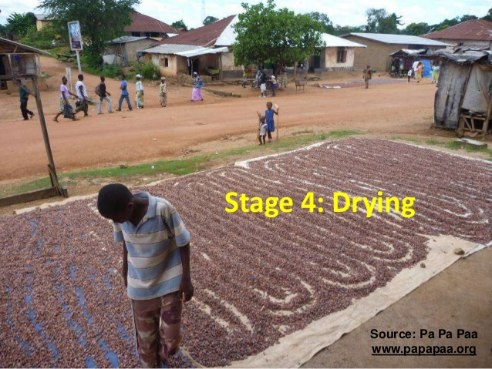
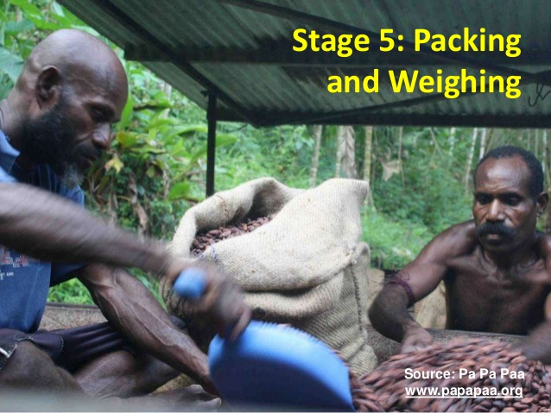
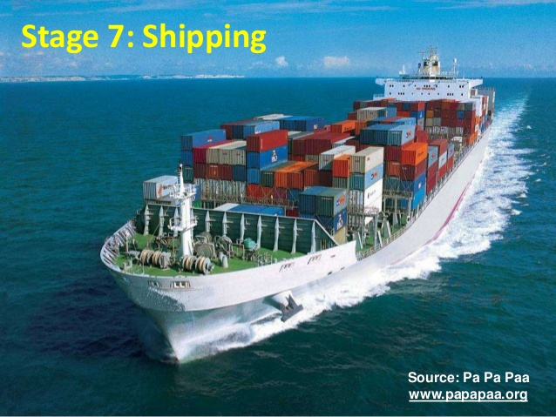
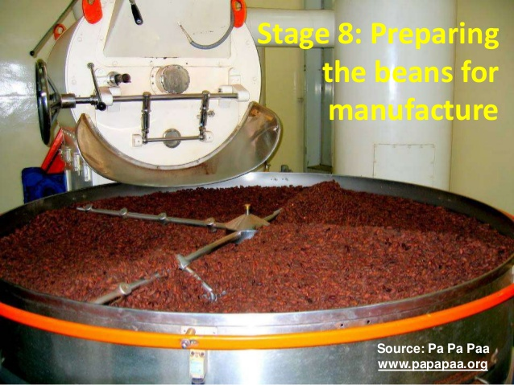
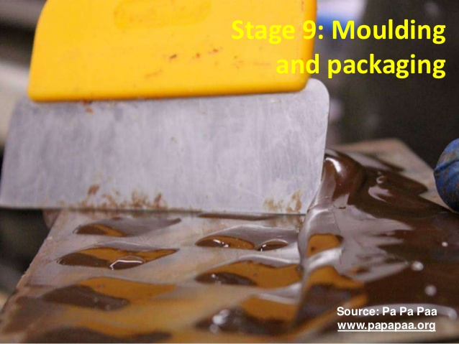
From Bean to Bar..

Slide 6
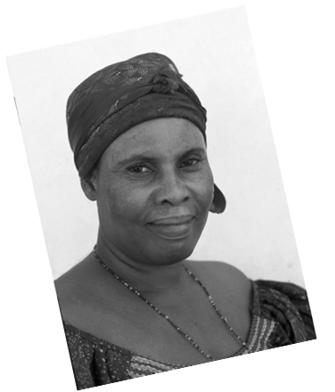
Kuapa Kokoo

Slide 7
You decide…
Is Fair Trade farming the answer to helping Ghana develop?
How can it solve some of the difficulties farmers in Ghana face?
What benefits does it create for the individual farmers?
What benefits does it create for the community?
How will it help the country as a whole?

