Slide 1
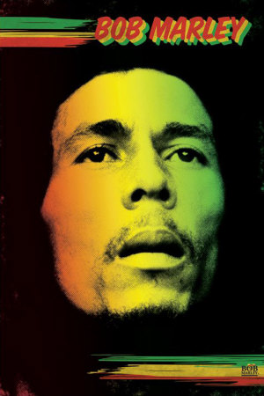

Slide 2
Learning Objectives
Be able to recognise characteristics of Reggae music
Be able to understand the importance of Bob Marley to Reggae music

Slide 3
What do you think of when you hear the word...
REGGAE?

Slide 4
Bob Marley
Jamaica
4 beats in the bar
1960s
REGGAE
Accent on 2 & 4
Simple songs
Ska & Rocksteady
Offbeat , syncopation

Slide 5
Where does Reggae come from?
Jamaica

Slide 6
The History of Reggae – [card sort] listen to the information then arrange the cards accordingly
In the 1930s and 1940s Mento and Calypso were two popular forms of music in Jamaica and the West Indies
In the 1950s, American Jazz and Rhythm and Blues [R & B] became the most popular style of music in Jamaica
This was a time of great change, when what had been mostly rural population began to move towards the cities, in particular the capital, Kingston, in search of work.
At this time, people would gather to listen to music on sound systems which were like a large mobile disco. Few people could afford their own record player or radio so this was the way they were able to listen to music.
In the mid 1960s a more soulful style of music had become popular called Rocksteady. This was similar to Ska although the vocals were more important than the instrumentals and the lyrics were about peoples’ lives and experiences.
In the late 1950s and 1960s, a new style of music emerged called Ska, which combined elements of Mento, Calypso and R & B, American Jazz, Blues and Swing music.
Rocksteady gave way to the new sound of Reggae in the late 1960s.

Slide 7
Key words
ACCENT –
a beat or note that is louder than the rest
CHORD –
3 or more notes sounded at the same time
RIFF –
A short tune, usually on a guitar but can be on a keyboard/organ

Slide 8
Listening to Reggae ‘Three Little Birds’ Bob Marley
Describe the opening? Loud, fast, slow, solo instrument, what instruments
Is there a strong bass riff?
What instrument plays the riff?
Which 2 beats of the bar are accented?
How many beats are in each bar?
What other instruments are playing?

Slide 9
Bob Marley

Slide 10
Bob Marley
One of the most important Reggae stars
Often the only Reggae artist people have heard of
Born in to a poor family in 1945
Grew up in Trenchtown, one of the poorest parts of Jamaica
Followed religion called Rastafarianism
Became famous in 1970s
Was in a famous band called ‘The Wailers’
Made Reggae popular and in the charts
Died in New York in 1980 of cancer

Slide 11
Hangman...

Slide 12
Task
Using the materials provided, create an informative poster about Reggae and Bob Marley.
Include facts and pictures
Make it informative and eye catching

Slide 13
Have we met our objective?
Be able to recognise characteristics of Reggae music
What does it sound like in terms of the actual music? What instruments will we expect to hear?
Be able to understand the importance of Bob Marley to Reggae music
What did he do for Reggae music?

Slide 14
Plenary Talk
The most important thing I learned today is...
I have found out several things on the topic of...
Firstly I found out that...
Furthermore, I found out that...
Discuss with a partner before you share it with the class.
Before this lesson I could already...
I was successful when I...
Today I have tried to...
Today I have learnt that...
I did not know how to... ....but now I can

Slide 16
Booklets
Name and form on front
Set 2/3 targets and write on back of old booklet
Answer the 3 RAG questions
Write in NEW BOOKLET on the centre 2 pages your current level which can be found on the back of your OLD BOOKLET
Write in your target grade [same as in old booklet]

Slide 17
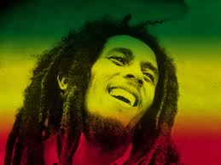
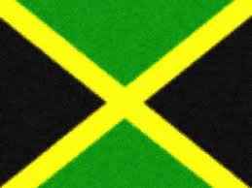
Key word warm up
Bob Marley

Slide 18
Starter - Blockbusters
http://www.teachers-direct.co.uk/resources/quiz-busters/quiz-busters-game.aspx?game_id=68560

Slide 19
Learning Objectives
To understand the term ‘syncopation’ and be able to perform a syncopated rhythm

Slide 20
Performing Reggae
What does Reggae sound like?
Laid back
Slow
Happy
Sad?

Slide 21
Performing Reggae
To perform reggae the most important thing is to remember that the chords play on the offbeat.
You need to count: 1,2,3,4/1,2,3,4/1,2,3,4/1,2,3,4 etc. When you are playing a Reggae song
You will play your chords on numbers 2 & 4.

Slide 22
Performing Reggae
Using the following chords practise playing a Reggae rhythm, remembering to play the chords on 2&4.
Your partner may need to count along with you to help
C = C, E & G G = G, B & D

Slide 23
SWANs
Write a SWAN for your partner
S – Strength
W – Weakness
ANS – And next steps
Put the date and write your name next to the date so we know who wrote it

Slide 24
Checking progress:
How much progress towards the learning objective have we made?
Learning Objective: To understand the term ‘syncopation’ and be able to perform a syncopated rhythm
Notes:
Use rag card sets. Try to encourage pupils to keep these on desks throughout the lesson and to change them as the lesson goes on [if they can remember the objective]

Slide 25
Plenary Talk
The most important thing I learned today is...
I have found out several things on the topic of...
Firstly I found out that...
Furthermore, I found out that...
Discuss with a partner before you share it with the class.
Before this lesson I could already...
I was successful when I...
Today I have tried to...
Today I have learnt that...
I did not know how to... ....but now I can

Slide 26
Completing Bob Marley Posters
One of the most important Reggae stars
Often the only Reggae artist people have heard of
Born in to a poor family in 1945
Grew up in Trenchtown, one of the poorest parts of Jamaica
Followed religion called Rastafarianism
Became famous in 1970s
Was in a famous band called ‘The Wailers’
Made Reggae popular and in the charts
Died in New York in 1980 of cancer

