Slide 1

DCF
Online Communication Tasks Success Criteria
DCF Strand 2 – Interacting & Collaborating

Slide 2

DCF
How to… Collaborate Online
Success Criteria
Use an online collaboration tool – Office 365 on Hwb
File > Share > Share with People > Type Email Address
Determine whether to share as view only or give editing rights by selecting from the drop down – do you want them just to view it or be able to make edits?

Slide 3
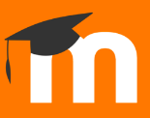

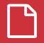
DCF
How to… Upload to Moodle
Success Criteria
Go to the school website > click the Moodle logo > log in using your school username and password (e.g. 22Joe.Bloggs)
Click ‘My Courses’ > find the subject you need
Click on the assignment > Add Submission > Files Icon > Upload a File > Choose File > Select the file > Upload this File > Save Changes
Insert video tutorial

Slide 4
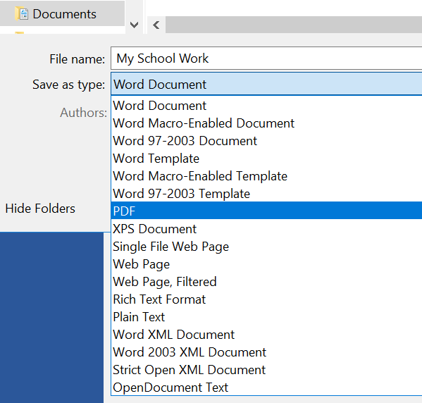
DCF
How to… Convert Files to PDF
Success Criteria
Open the file
File > Save as > Browse > Click the drop down ‘Save as type’ > select PDF > Save
Upload the file to Moodle!

Slide 5
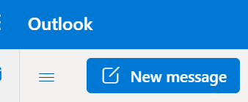
DCF
How to… Send an Email
Success Criteria
Log in to Hwb > Office365 > Outlook
Click ‘New Message’
Always add a subject to tell the recipient what your email is about
Start your email with Dear or Annwyl
Don’t use abbreviations. E.g. use you instead of u
End your email with a polite sign-off phrase – Kind regards, Many thanks, Diolch yn fawr, Cofion cynnes

