Slide 2
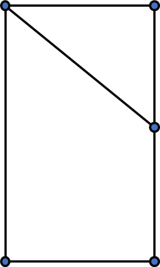
A geometric figure is shown to the right.
Use letter notation to fill in the blanks in
the statements below.
Angle ______ is a right-angle.
Line segments ____ and ____ are vertical.
Shape ________ is a triangle.
Shape __________ is a quadrilateral.
A
B
E
C
D

Slide 3
A geometric figure is shown to the right.
Use letter notation to fill in the blanks in
the statements below.
Angle ______ is a right-angle.
Line segments ____ and ____ are vertical.
Shape ________ is a triangle.
Shape __________ is a quadrilateral.
A
B
ACD
AC
BD
E
ABE
ABDC
(or AEDC)
C
D

Slide 4
Draw a trapezium and label the vertices KLMN.
Draw a line segment from point L to point N.
Use three letter notation to identify the triangles formed within the trapezium.

Slide 5
Draw a trapezium and label the vertices KLMN.
Draw a line segment from point L to point N.
Use three letter notation to identify the triangles formed within the trapezium.
e.g.
K
L
N
M
The triangles are KLN and LMN.
Discuss other possible answers as a class.

Slide 6
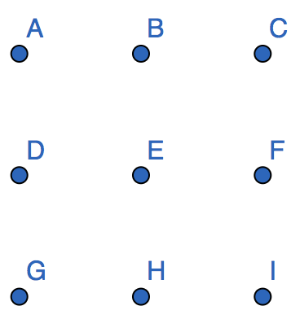
How many squares can you construct using the points labelled?
Use letter notation to name each one.

Slide 7
How many squares can you construct using the points labelled?
Use letter notation to name each one.
6 squares including BDHF shown.
The others are
ACIG
ABED
BCEF
DEHG
EFHI

Slide 8
WXYZ is a square. Side XY is 5 cm long.
Draw the square and find the lengths of its diagonals WY and XZ.
Is there more than one way to draw this square?
Investigate if WXYZ were a rhombus instead.

Slide 9
WXYZ is a square. Side XY is 5 cm long.
Draw the square and find the lengths of its diagonals WY and XZ.
Is there more than one way to draw this square?
Investigate if WXYZ were a rhombus instead.
Discuss solutions as a class.

Slide 10
Eva is measuring the length from point A to point B.
What mistake has Eva made? What advice would you give her?
A
B
I think the length is 4.8 cm.

Slide 11
Eva is measuring the length from point A to point B.
What mistake has Eva made? What advice would you give her?
A
B
I think the length is 4.8 cm.
Eva has measured from zero.
The length of line segment AB $=4.8−0.9=3.9$cm

Slide 12
Line A is $4\frac{1}{4}$ cm long. Line B is 70 mm shorter than line A.
Lines C and D are drawn accurately below.
Put these lines in ascending length order.
C
D

Slide 13
Line A is $4\frac{1}{4}$ cm long. Line B is 70 mm shorter than line A.
Lines C and D are drawn accurately below.
Put these lines in ascending length order.
Use a ruler to measure the lines.
Compare the line lengths and order from smallest to largest.
C
D

Slide 14
A diver performs a dive with two and a half-turns.
How many degrees do they rotate through?

Slide 15
A diver performs a dive with two and a half-turns.
How many degrees do they rotate through?
Two and a half turns $=$ $360°×2+180°=900°$

Slide 16
A ship is sailing North. It turns to face east.
Mo and Rosie are discussing how far the ship has turned.
Who do you agree with? Why?
I think the ship has turned one quarter turn clockwise.
I think the ship has turned 270°

Slide 17
A ship is sailing North. It turns to face east.
Mo and Rosie are discussing how far the ship has turned.
Who do you agree with? Why?
I think the ship has turned one quarter turn clockwise.
I think the ship has turned 270°
Both could be correct. The direction of turn is not stated in the question.

Slide 18
Write down three things in your classroom which turn through an angle.

Slide 19
Write down three things in your classroom which turn through an angle.
Discuss answers as a class.
Possible examples include:
opening the classroom door
opening a cupboard door
closing a window
Turning a table/chair to face in a different direction
etc.

Slide 20
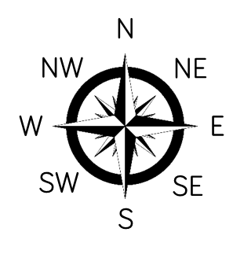
Sam starts by facing North.
She turns clockwise to face West.
How many degrees has she turned through?
Asif is facing East.
He turns anticlockwise through 540°
Which direction is he now facing?
Alicia starts by facing South East.
She turns clockwise through 270°
Which direction is she now facing?

Slide 21
Sam starts by facing North.
She turns clockwise to face West.
How many degrees has she turned through?
Asif is facing East.
He turns anticlockwise through 540°
Which direction is he now facing?
Alicia starts by facing South East.
She turns clockwise through 270°
Which direction is she now facing?
She’s turned 270$°$
He’s now facing West.
She’s now facing North East.

Slide 22
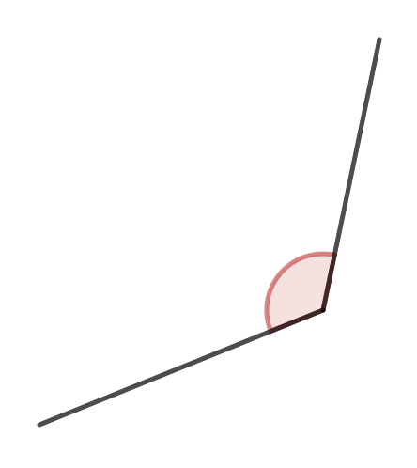
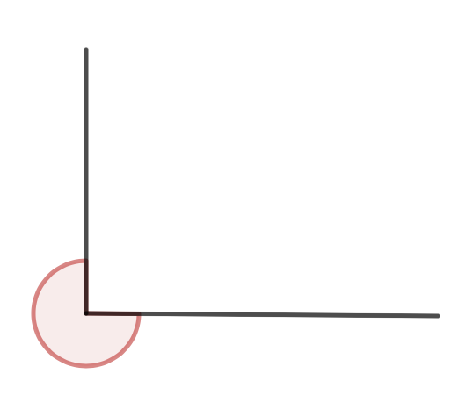
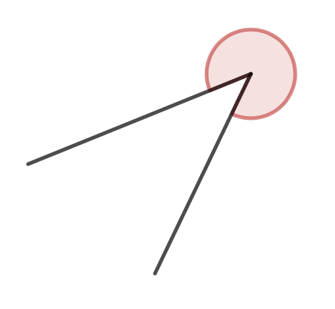
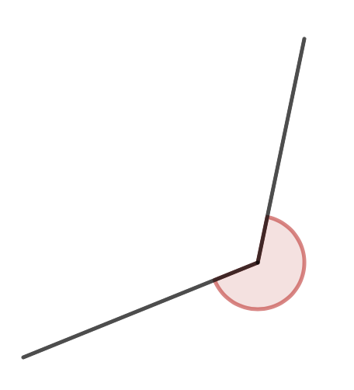
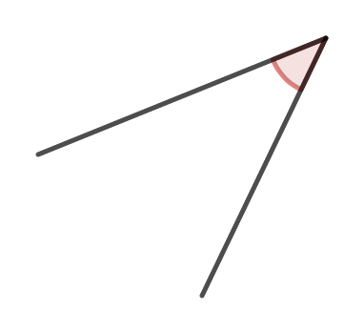
Classify the angles as acute, obtuse, reflex or right-angles.

Slide 23
Classify the angles as acute, obtuse, reflex or right-angles.
right-angle
obtuse
reflex
reflex
reflex
acute

Slide 24
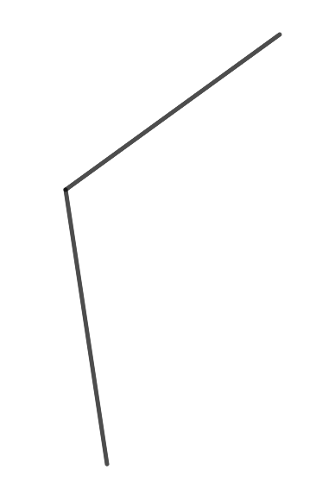
Amir says angle ABC is obtuse.
Whitney says angle ABC is a reflex angle.
Who is correct and why?
B
C
A

Slide 25
Amir says angle ABC is obtuse.
Whitney says angle ABC is a reflex angle.
Who is correct and why?
Either Amir or Whitney could be correct as the arc isn’t marked.
(Usually ABC means the non-reflex angle)
B
C
A

Slide 26
Complete the table about the interior angles for each of the shapes.
Repeat for the exterior angles of each shape.
Shape | Acute angles | Obtuse angles | Reflex angles | Right-angles
A
B
C

Slide 27
Complete the table about the interior angles for each of the shapes.
Repeat for the exterior angles of each shape.
Shape | Acute angles | Obtuse angles | Reflex angles | Right-angles
A | 1 | 2 | 0 | 2
B | 1 | 1 | 0 | 2
C | 3 | 0 | 1 | 0
Discuss as a class

Slide 28
Alex and Dora measure the angle using a protractor.
Who do you agree with? Why?
The angle is 40°
Alex
The angle is 140°
Dora

Slide 29
Alex and Dora measure the angle using a protractor.
Who do you agree with? Why?
The angle is 40°
Alex
The angle is 140°
Dora
Dora, because this is an obtuse angle and it’s greater than 90$°$

Slide 30
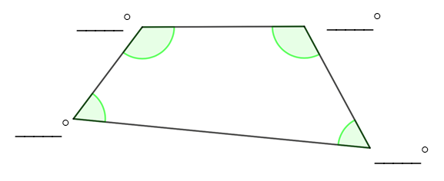
Measure the size of each of the interior angles in the shape.

Slide 31
Measure the size of each of the interior angles in the shape.
Allow $±$ 2$°$
127
119
59
55

Slide 32
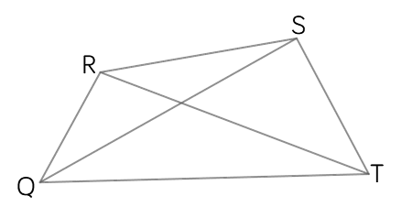
Complete the statements about the diagram.
$∠$RTS is
$∠$QRS is
The sum of angles SRT and QRT is
The difference between angles QST and SQT is

Slide 33
Complete the statements about the diagram.
$∠$RTS is
$∠$QRS is
The sum of angles SRT and QRT is
The difference between angles QST and SQT is
Allow $±$ 2$°$
40$°$
22$°$
129$°$
120$°$

Slide 34
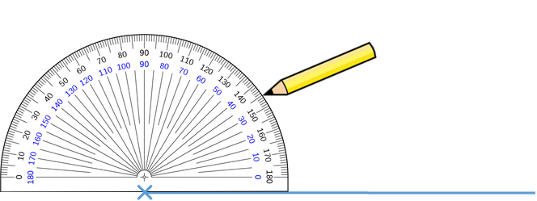
Teddy is drawing an angle of 35°
He marks the angle with his pencil as shown.
Will Teddy’s diagram show the correct angle? How do you know?

Slide 35
Teddy is drawing an angle of 35°
He marks the angle with his pencil as shown.
Will Teddy’s diagram show the correct angle? How do you know?
No, because Teddy hasn’t placed the cross of the protractor at the vertex, so the drawing will be inaccurate.

Slide 36
Eva, Mo and Whitney draw a 63° angle at point A and a 15° angle at point B on the line.
Who is correct? Demonstrate your reasoning by drawing a diagram.
My lines have made a triangle.
My lines don’t form a shape.
Eva
Mo
4cm
My lines have made a different triangle to Eva’s.
A
B
Whitney

Slide 37
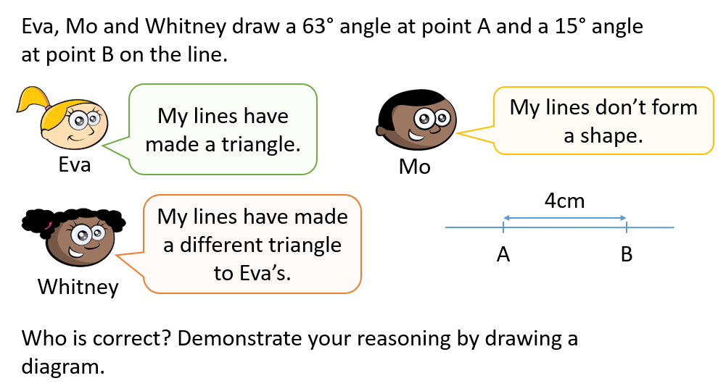
Mo’s angles may not intersect
There is only one possible triangle. However the orientation of
the triangle could be different.
63°
15°
A
B

Slide 38
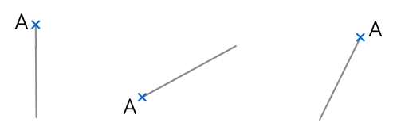
In each diagram, measure and draw an angle of 115° at point A.

Slide 39
In each diagram, measure and draw an angle of 115° at point A.
For example,
115$°$
115$°$
115$°$

Slide 40
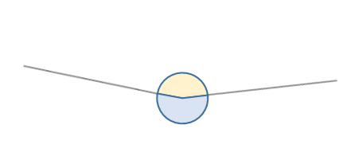
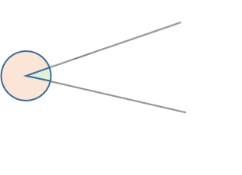
Measure all four angles shown.

Slide 41
Measure all four angles shown.
Allow $±$ 2$°$
161$°$
199$°$
329$°$
31$°$

Slide 42
Draw an angle of 258° at point A.
How many ways can you do this?

Slide 43
Draw an angle of 258° at point A.
How many ways can you do this?
Two – clockwise from A and anticlockwise from A

Slide 44
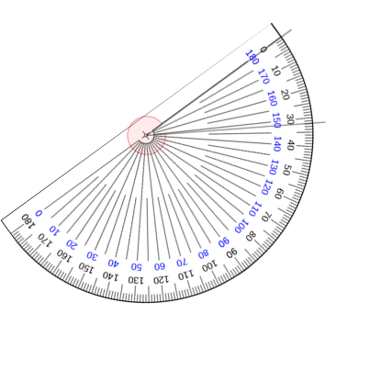
Circle the correct size of the angle.
What mistakes have been made for the other answers?
A
32°
B
148°
C
322°
D
212°

Slide 45
Circle the correct size of the angle.
What mistakes have been made for the other answers?
A
32°
B
148°
C
322°
D
212°
e.g. B – read wrong scale, C – measured reflex angle instead of acute
D – added 180

Slide 46
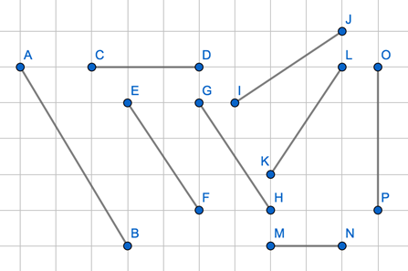
Complete the sentences using two letter notation for each line segment.
CD is parallel to
IJ is perpendicular to
EF is neither parallel nor perpendicular to

Slide 47
Complete the sentences using two letter notation for each line segment.
CD is parallel to MN
IJ is perpendicular to HG (or EF)
EF is neither parallel nor perpendicular to MN (or CD, KL, OP)

Slide 48
Eva thinks that the lines are parallel.
Is she right?

Slide 49
Eva thinks that the lines are parallel.
Is she right?
No, parallel lines must be straight lines with a constant perpendicular distance.

Slide 50
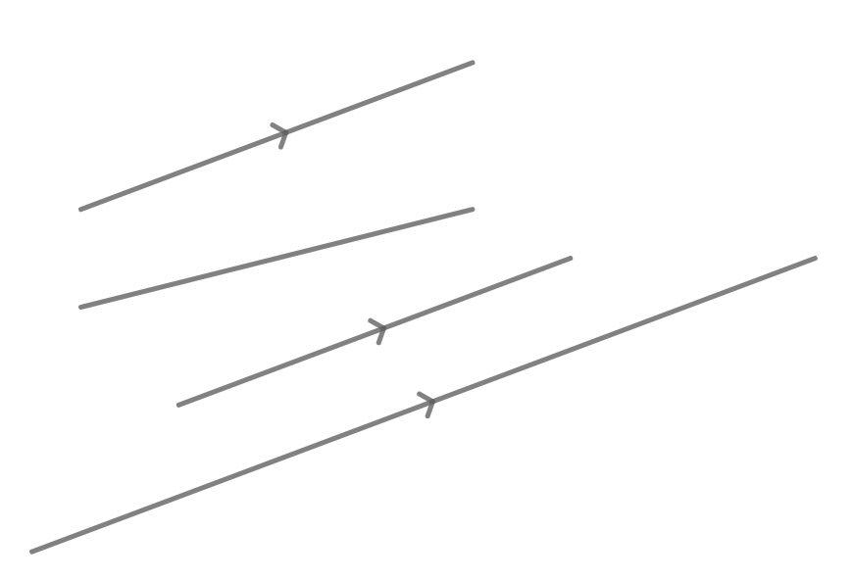
Which of the line segments are parallel?
B
A
D
F
H
C
E
G

Slide 51
Which of the line segments are parallel?
Line segments AB, EF and GH are all parallel to each other
B
A
D
F
H
C
E
G

Slide 52
Tommy says the lines can’t be perpendicular because they don’t cross. Do you agree?

Slide 53
Tommy says the lines can’t be perpendicular because they don’t cross. Do you agree?
You cannot tell – if the line segments were extended, they might meet at a right angle.

Slide 54
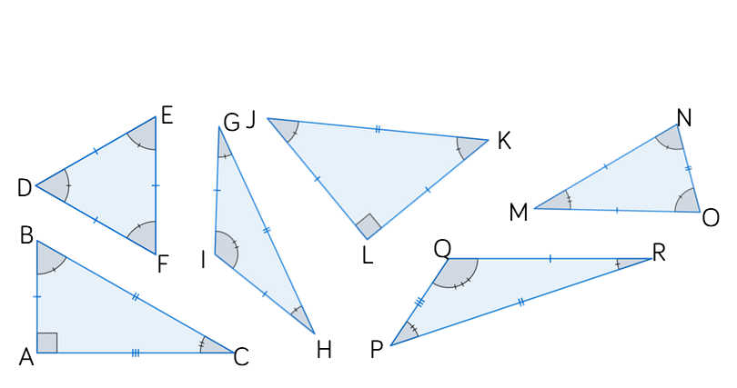
Classify the following triangles as equilateral, isosceles, scalene or right-angled. Is there more than one category for each triangle?

Slide 55
Classify the following triangles as equilateral, isosceles, scalene or right-angled. Is there more than one category for each triangle?
Right-angled
& isosceles
Isosceles
Equilateral
Scalene
Isosceles
Right-angled
& scalene

Slide 56
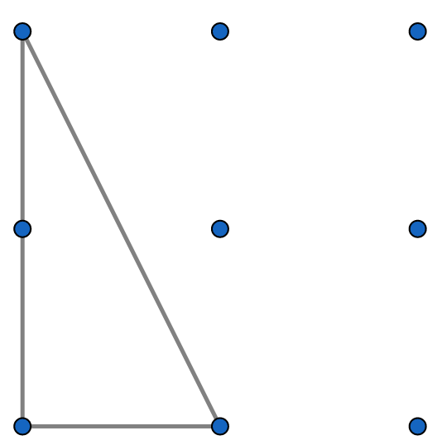
Make as many different triangles as possible using a 3 by 3 geoboard. Classify each triangle.
One example is shown.
Are there any types of triangle you cannot make?

Slide 57
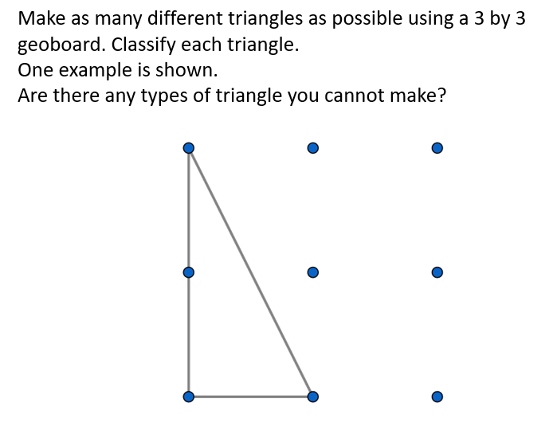
You cannot make an equilateral triangle.
Right angled
& isosceles
Isosceles
Isosceles
Right angled
& isosceles
Right angled
& scalene
Isosceles
Scalene
Scalene

Slide 58
Use Cuisenaire rods to construct triangles using one piece per side.
What types of triangles can you create? Are there any types that you can’t create?
Can you generalise?
Record your results in a table.

Slide 59
e.g.
Cuisenaire 1 | Cuisenaire 2 | Cuisenaire 3 | Type of triangle created
Yellow | Yellow | Yellow | Equilateral triangle
Red | Blue | Green | Scalene triangle
Red | Red | Blue | Isosceles triangle

Slide 60
Create a 4 by 4 square on your geoboard.
By moving only one vertex, which of the following can you make?
Create a 4 by 6 rectangle on your geoboard.
By moving only one vertex, which of the following can you make?
How do your answers change if you’re allowed to move 2 vertices?
Kite | Trapezium |  | Parallelogram |  | Rhombus
Kite | Trapezium |  | Parallelogram |  | Rhombus

Slide 61
Create a 4 by 4 square on your geoboard.
By moving only one vertex, which of the following can you make?
Create a 4 by 6 rectangle on your geoboard.
By moving only one vertex, which of the following can you make?
How do your answers change if you’re allowed to move 2 vertices?
Kite | Trapezium |  | Parallelogram |  | Rhombus
Kite | Trapezium |  | Parallelogram |  | Rhombus
Compare answers as a class

Slide 62
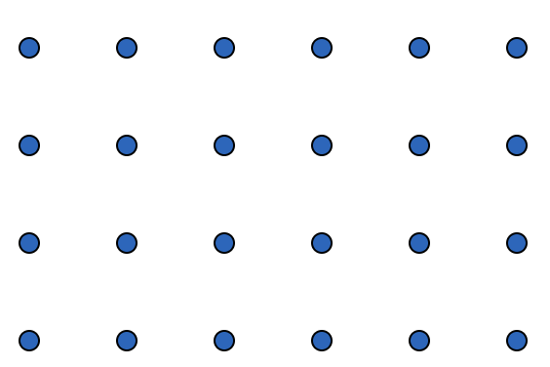
Sort the shapes into two groups, those that are rectangles and those that are not.

Slide 63
Sort the shapes into two groups, those that are rectangles and those that are not.
Not a rectangle
Not a rectangle
Rectangle
Not a rectangle
Rectangle
Rectangle
Rectangle

Slide 64
A plan of a building is shown.
What else does Jack need to check to show that he is correct?
The building is in the shape of a rectangle because the opposite sides are equal in length.
46 m
13 m
13 m
46 m

Slide 65
A plan of a building is shown.
What else does Jack need to check to show that he is correct?
The building is in the shape of a rectangle because the opposite sides are equal in length.
46 m
13 m
13 m
46 m
Jack needs to also include information about the angles to ensure they are all right angles.

Slide 66
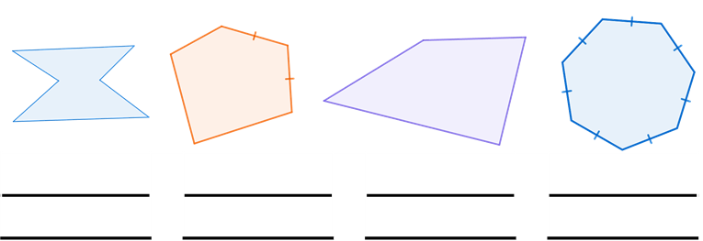
Write the name of each polygon and decide whether it is regular or irregular.

Slide 67
Write the name of each polygon and decide whether it is regular or irregular.
Irregular
Irregular
Irregular
regular
hexagon
pentagon
quadrilateral
heptagon

Slide 68
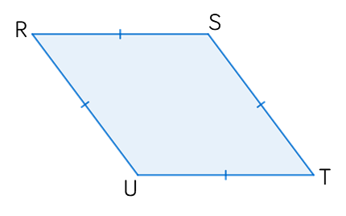
Jack says that the shape, RSTU, is a regular polygon.
Explain Jack’s mistake.

Slide 69
Jack says that the shape, RSTU, is a regular polygon.
Explain Jack’s mistake.
The sides are all the same length, but the angles are not equal.

Slide 70
How many types of polygon can be made by attaching the following two shapes at their edges?

Slide 71
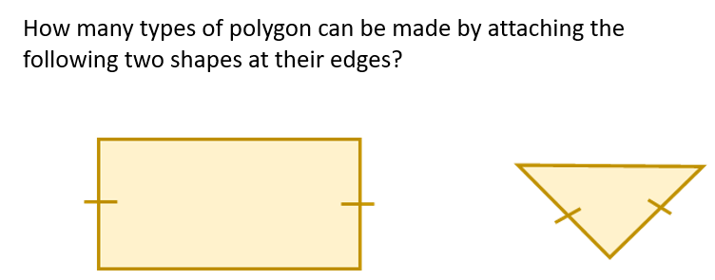
Here are some examples.
Compare answers as a class, deciding whether
sides must be fit exactly alongside each other.

Slide 72
Construct a line segment AB 10 cm long.
Plot point C such that AC and BC have lengths 8 cm
and 5.5 cm respectively.
Measure the angle at each vertex and classify the triangle.
What equipment did you use?
Why is it more accurate to use a pair of compasses?

Slide 73
Construct a line segment AB 10 cm long.
Plot point C such that AC and BC have lengths 8 cm
and 5.5 cm respectively.
Measure the angle at each vertex and classify the triangle.
What equipment did you use?
Why is it more accurate to use a pair of compasses?
C
$∠$CAB $≈$ 33$°$
$∠$ABC $≈$ 53$°$
$∠$ACB $≈$ 94$°$
A
B
The triangle is scalene.
Using a pair of compasses will give the exact position of C

Slide 74
Construct a triangle with side lengths 6 cm, 8 cm and 10 cm.
What do you notice about this triangle?

Slide 75
Construct a triangle with side lengths 6 cm, 8 cm and 10 cm.
What do you notice about this triangle?
This is a right-angled triangle.
8 cm
6 cm
10 cm

Slide 76
Explain why you cannot construct a triangle with side lengths 4 cm, 5 cm and 11 cm.
Can you come up with another set of side lengths that will not make a triangle?
How do you know?

Slide 77
Explain why you cannot construct a triangle with side lengths 4 cm, 5 cm and 11 cm.
Can you come up with another set of side lengths that will not make a triangle?
How do you know?
Because 4 + 5 < 11, so the sides would not meet.
Compare other examples as a class.
For sides $a, b$and $c$ to form a triangle, each of these inequalities must be true:
$$a+b>c$$
$$a+c>b$$
$$b+c>a$$

Slide 78
Here is a rhombus with side lengths of 7 cm and a longest diagonal of 10 cm.
Use a pair of compasses to construct a rhombus with sides of 5 cm and a longest diagonal of 8 cm.
7 cm
10 cm

Slide 79
Here is a rhombus with side lengths of 7 cm and a longest diagonal of 10 cm.
Use a pair of compasses to construct a rhombus with sides of 5 cm and a longest diagonal of 8 cm.
7 cm
10 cm
Start with the 10 cm diagonal and construct isosceles triangles
of 10 cm, 7 cm and 7 cm from both sides of this.

Slide 80
Construct a triangle WXY such that angle WXY is 40° and lengths WX and WY are integers that add to make 13 cm.
How many unique triangles can you construct?
Explain why this is possible.

Slide 81
Construct a triangle WXY such that angle WXY is 40° and lengths WX and WY are integers that add to make 13 cm.
How many unique triangles can you construct?
Explain why this is possible.
W
There are two possibilities when WX = 7 cm
and WY = 6 cm
Compare other possibilities as a class
6 cm
W
6 cm
X
40$°$
Y
7 cm

Slide 82
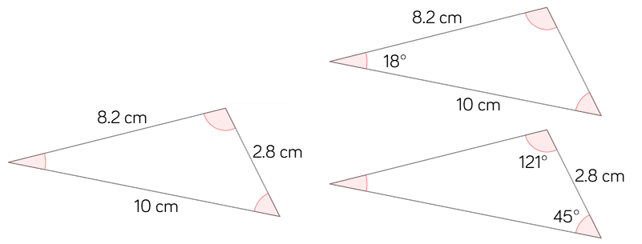
Which of the triangles are identical?
You must draw each triangle accurately and give reasons for your answer
Diagrams not drawn accurately.

Slide 83
Which of the triangles are identical?
You must draw each triangle accurately and give reasons for your answer
Diagrams not drawn accurately.
None of the triangles are identical as the angles are not equal

Slide 84
Describe three different ways to construct an equilateral triangle with perimeter 189 mm.

Slide 85
Describe three different ways to construct an equilateral triangle with perimeter 189 mm.
189 $÷$ 3 = 63 mm
SSS use a pair of compasses to construct all three sides as 63mm
SAS construct two sides of 63 mm with a 60 degree angle between them
AAS one side 63 mm with 60 degree angle at both ends

Slide 86
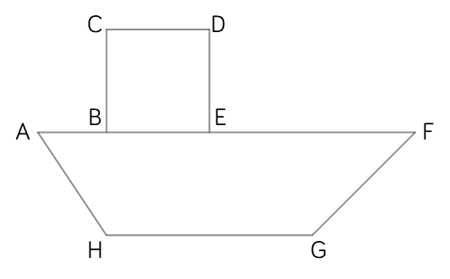
The boat has been constructed using 2-D shapes.
BCDE is a square with side length 3 cm.
Line segment BA is 2.4 cm long.
Point H is 3 cm directly beneath point B.
Line segment BF is 8.8 cm long.
Angle EFG is 45°
Construct an accurate diagram
of the boat and complete the
information below.
Length AH = ____
∠AHG = ____
Perimeter = ____
The height of the boat is ____.

Slide 87
The boat has been constructed using 2-D shapes.
BCDE is a square with side length 3 cm.
Line segment BA is 2.4 cm long.
Point H is 3 cm directly beneath point B.
Line segment BF is 8.8 cm long.
Angle EFG is 45°
Construct an accurate diagram
of the boat and complete the
information below.
Length AH = 3.8 cm
∠AHG = 129$°$
Perimeter = 31 cm
The height of the boat is 6 cm
45°
135°

Slide 88
Construct a rhombus EFGH with side length 5.7 cm and angle FGH measuring 53°
Measure and state the lengths of the diagonals using two-letter notation.

Slide 89
Construct a rhombus EFGH with side length 5.7 cm and angle FGH measuring 53°
Measure and state the lengths of the diagonals using two-letter notation.
FH $=$ 5.1 cm
EG $=$ 10.2 cm

Slide 90
Can you construct a regular hexagon with side lengths 7 cm without using a protractor?

Slide 91
Can you construct a regular hexagon with side lengths 7 cm without using a protractor?
You can create six equilateral triangles, each with a side length of 7cm and connect these to form a regular hexagon.
7cm

Slide 92
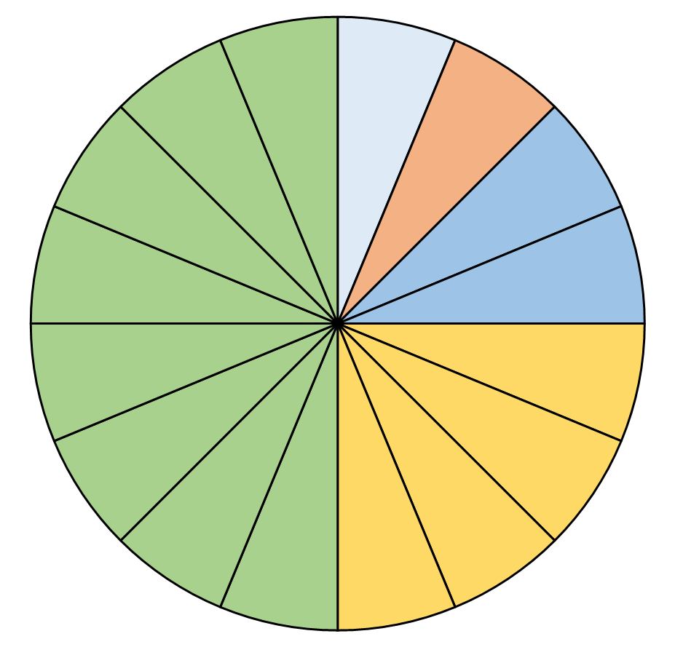
The pie chart below shows the favourite fruits of a class. There are 32 students in the class.
What fraction prefer bananas?
How many more students prefer
oranges to apples?
What was the least popular fruit?
Kiwi
Strawberries
Apples
Oranges
Bananas

Slide 93
The pie chart below shows the favourite fruits of a class. There are 32 students in the class.
What fraction prefer bananas?
How many more students prefer
oranges to apples?
What was the least popular fruit?
$$\frac{4}{16}=\frac{1}{4}$$
12 students
Kiwi
Strawberries
Kiwis and strawberries
Apples
Oranges
Bananas

Slide 94
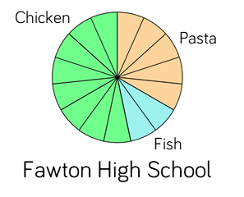
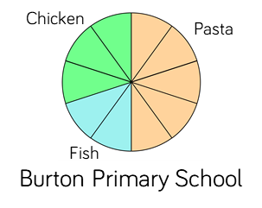
The pie charts below show what students at two different schools chose for their lunch one day. Do you agree with the statements?
Half of the children at Burton Primary chose pasta.
More children chose pasta at Fawton High than at Burton Primary.

Slide 95
The pie charts below show what students at two different schools chose for their lunch one day. Do you agree with the statements?
Half of the children at Burton Primary chose pasta.
More children chose pasta at Fawton High than at Burton Primary.
True
We don’t know how many students there were in each class so we can’t tell.

Slide 96
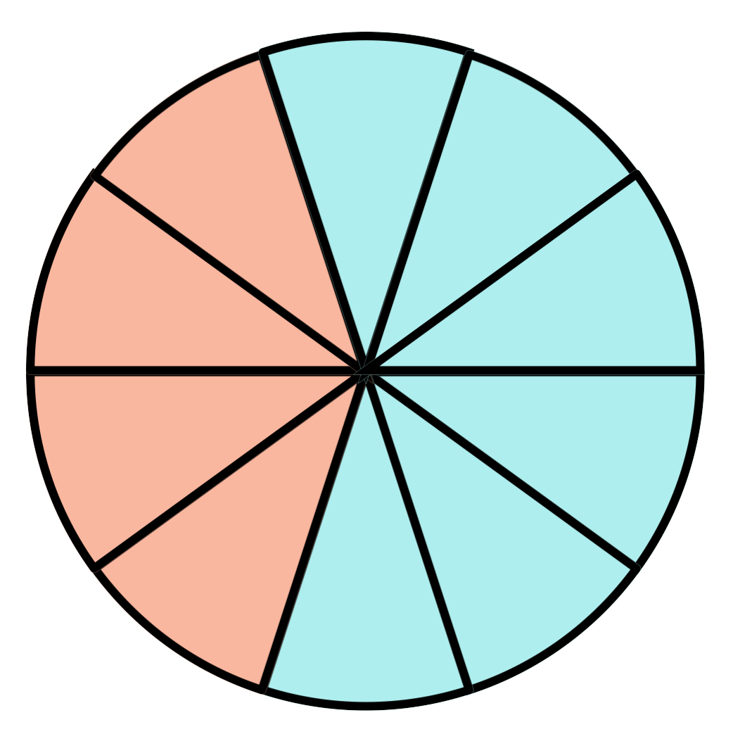
The pie chart shows the proportions of adults and children attending a musical. 240 children attended the musical.
How many people attended the musical
altogether?
Children
Adults

Slide 97
The pie chart shows the proportions of adults and children attending a musical. 240 children attended the musical.
How many people attended the musical
altogether?
Children
Adults
400 people attended altogether.

Slide 98
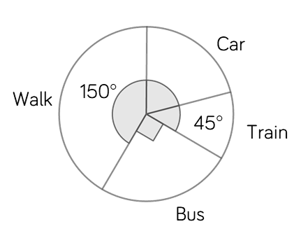
The pie chart shows how a group of employees travel to work. There are 24 employees.
Explain how the following were worked out.
How many people came by car?
How many ways could you work this out?
“a quarter of the people go by bus. So 6 people go by bus.”
$$\frac{150}{360}×24=10$$
So 10 people walk.
$$\frac{45}{360}=\frac{1}{8}$$
One eighth of 24 is 3

Slide 99
The pie chart shows how a group of employees travel to work. There are 24 employees.
Explain how the following were worked out.
How many people came by car?
How many ways could you work this out?
“a quarter of the people go by bus. So 6 people go by bus.”
$$\frac{150}{360}×24=10$$
So 10 people walk.
$$\frac{45}{360}=\frac{1}{8}$$
One eighth of 24 is 3
5 people
Compare strategies as a class

Slide 100
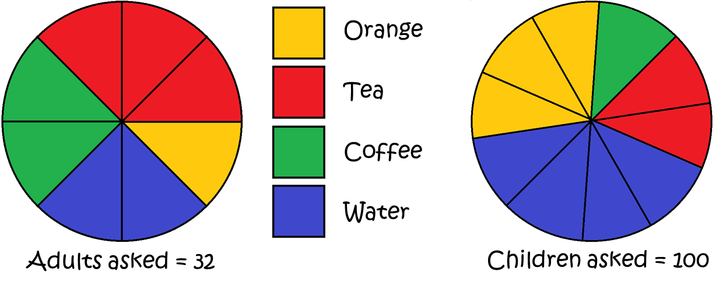
The pie charts shows favourite drinks.
What fraction of adults prefer tea?
Which group has the most tea drinkers?

Slide 101
The pie charts shows favourite drinks.
What fraction of adults prefer tea?
Which group has the most tea drinkers?
$$\frac{3}{8}$$
The children

Slide 102
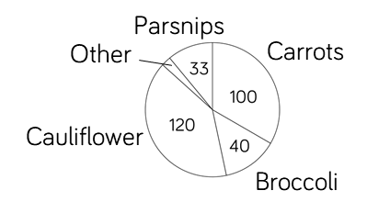
300 students were asked to name their favourite vegetable given the options carrots, broccoli, cauliflower, parsnips and other. How many chose other?
Which vegetable was chosen by 40% of the students?

Slide 103
300 students were asked to name their favourite vegetable given the options carrots, broccoli, cauliflower, parsnips and other. How many chose other?
Which vegetable was chosen by 40% of the students?
7
Cauliflower

Slide 104
The table contains information about the cars in a car park.
Complete the table and draw a pie chart to represent the data.
Manufacturer | Frequency | Angle of sector
Volvo | 10
BMW | 8
Ford | 16
Kia | 11

Slide 105
The table contains information about the cars in a car park.
Complete the table and draw a pie chart to represent the data.
Manufacturer | Frequency | Angle of sector
Volvo | 10 | 80$°$
BMW | 8 | 64$°$
Ford | 16 | 128$°$
Kia | 11 | 88$°$
Kia
88$°$
Volvo
80$°$
BMW
64$°$
Ford
128$°$

Slide 106
The table contains information about the colour of students eyes in class 8a. There are 30 students in class 8a. Complete the table and draw a pie chart to represent the data.
Manufacturer | Frequency | Angle of sector
Brown | 6
Hazel | 8
Blue |  | 60°
Green |  | 48°
Silver | 2
Amber

Slide 107
The table contains information about the colour of students' eyes in class 8a. There are 30 students in class 8a. Complete the table and draw a pie chart to represent the data.
Manufacturer | Frequency | Angle of sector
Brown | 6 | 72$°$
Hazel | 8 | 96$°$
Blue | 5 | 60°
Green | 4 | 48°
Silver | 2 | 24$°$
Amber | 5 | 60$°$
Brown
72$°$
Blue
60$°$
Green
48$°$
Hazel
96$°$
Amber
60$°$
24$°$
Silver

Slide 108
Tahir is drawing a pie chart using the frequency table.
Tahir’s calculations are in red. Explain the mistake Tahir has made and then construct an accurate pie chart.
Sport | Frequency
Hockey | 20 |  | 0.25 $×$ 20 $=$ 5°
Rugby | 28 |  | 0.25 $×$ 28 $=$ 7°
Football | 16 |  | 0.25 $×$ 16 $=$ 4°
Basketball | 26 |  | 0.25 $×$ 26 $=$ 6.5°
20 $+$ 28 $+$ 16 $+$ 26 $=$ 90 90 $÷$ 360 $=$ 0.25

Slide 109
Tahir is drawing a pie chart using the frequency table.
Tahir’s calculations are in red. Explain the mistake Tahir has made and then construct an accurate pie chart.
Sport | Frequency
Hockey | 20 |  | 0.25 $×$ 20 $=$ 5°
Rugby | 28 |  | 0.25 $×$ 28 $=$ 7°
Football | 16 |  | 0.25 $×$ 16 $=$ 4°
Basketball | 26 |  | 0.25 $×$ 26 $=$ 6.5°
20 $+$ 28 $+$ 16 $+$ 26 $=$ 90 90 $÷$ 360 $=$ 0.25
Tahir should have worked out 360 $÷$ 90 $=$ 4$°$ per unit and then multiplied each frequency value by 4 to give the number of degrees for each sector.

