Slide 1
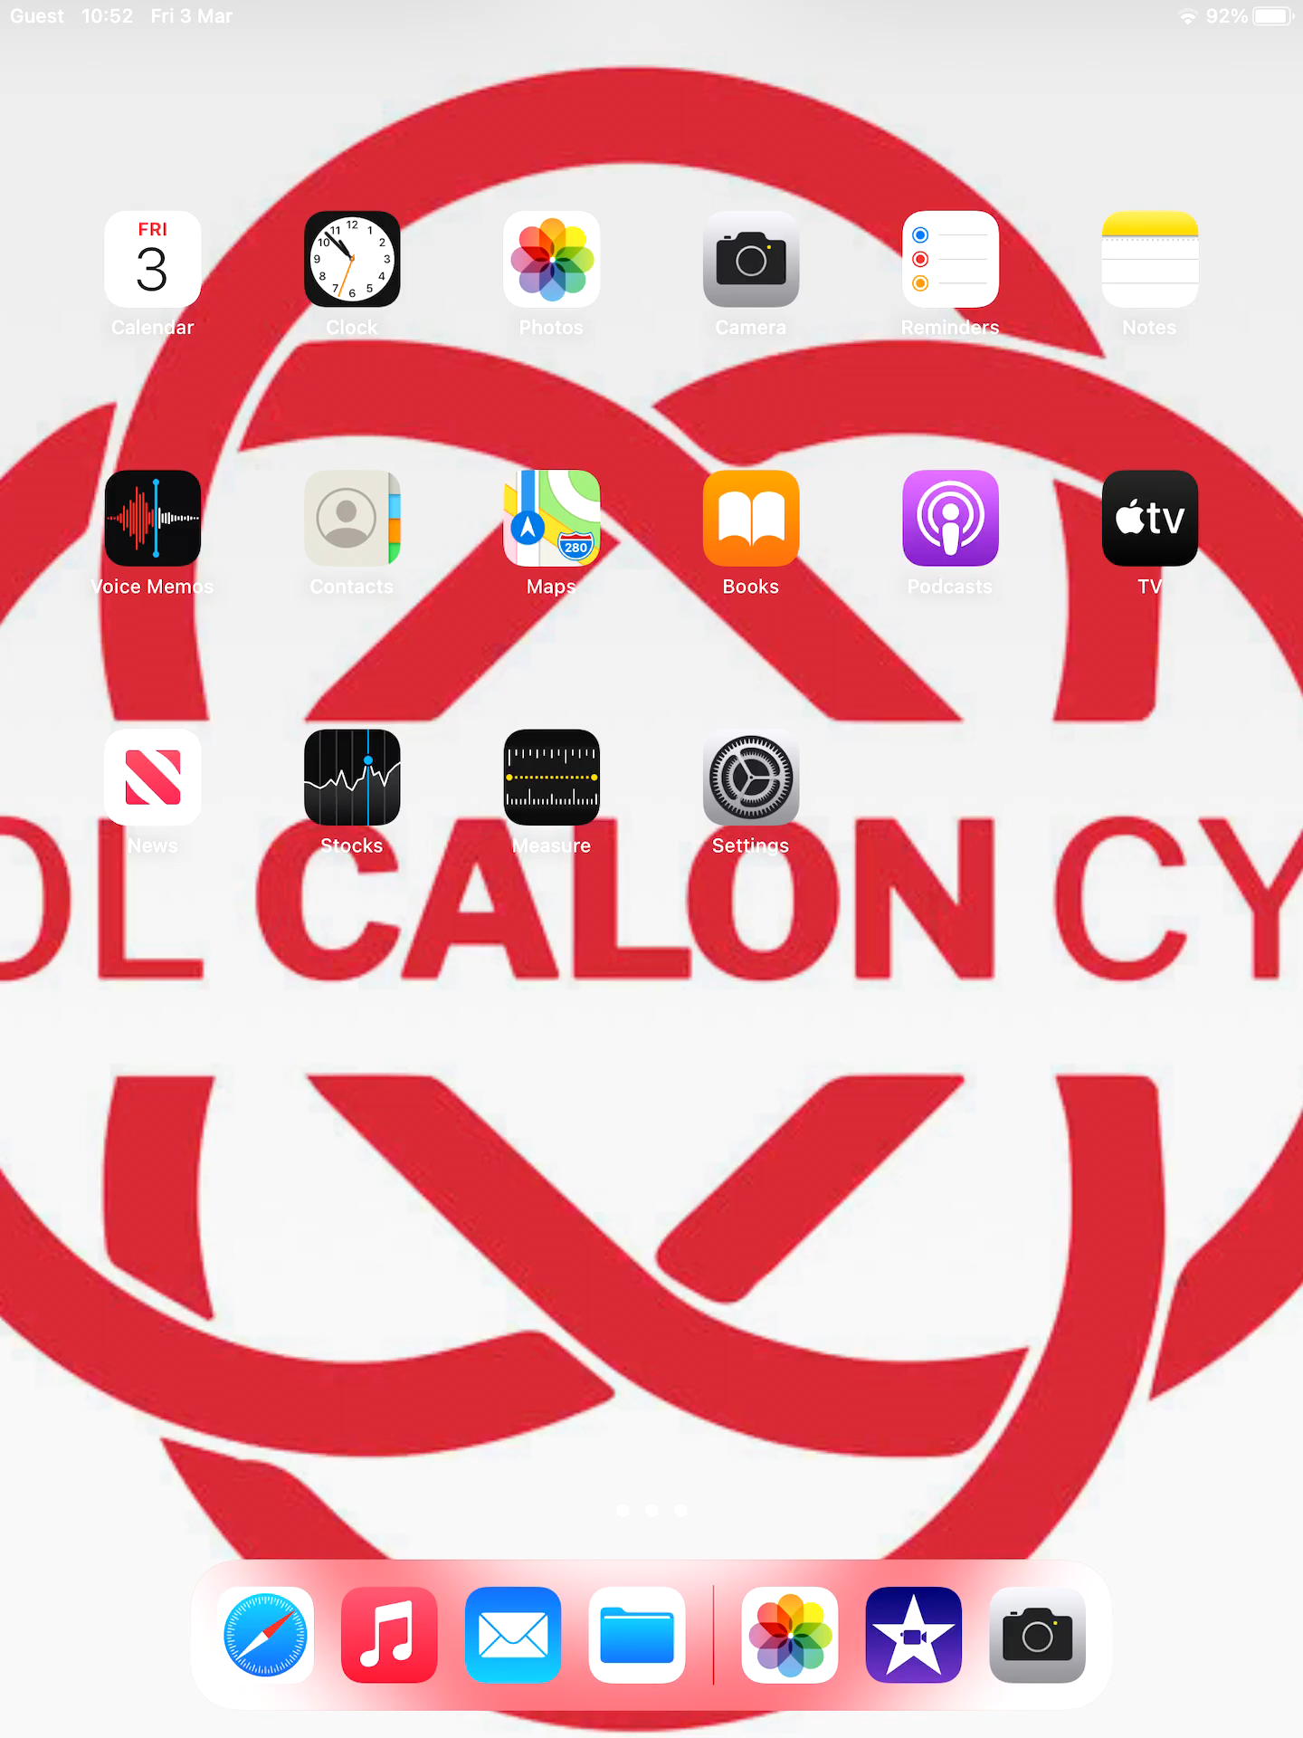
DCF
How to… use Green Screen in iMovie
Watch the tutorial video opposite!
Step 1: Open the iMovie app
Step 2: Click the + and click ‘Movie’
Step 3: Select a background image from photos and click ‘Create Movie’
Step 4: Scroll the bar at the bottom back to the start
Step 5: Click the + at the top right and select a video to upload
Step 6: Click the three dots on the video and click ‘Green/Blue Screen’

